Slide 1

Bayelsa State RMNCAHN Report for January, 2024
Data Source: DHIS2
February, 2024
Data was downloaded February 19, 2024 @ 12.37am

Slide 2
Presentation Outline
  Brief State background
  Reports of key indicators
  Maternal indicators
    LGA Performance
  Child health indicators
  Key Findings

Slide 3

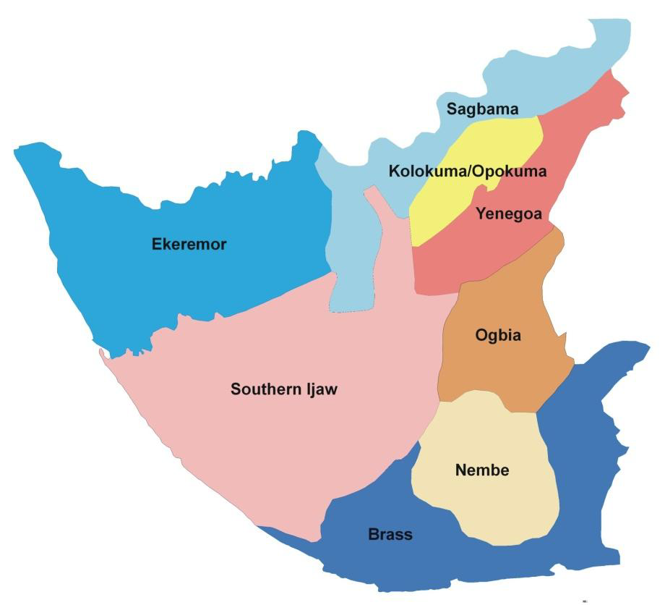






State Background
2,769,283
8
110,771
553,857
138,646
RMNCAH+N Facilities
299 HF
105

Slide 4
Maternal Health Indicators

Slide 5
Comparing % of Deliveries Taken by Skilled Birth Attendants in December 2023 & January 2024
Total Deliveries
Dec-23 | 593
Jan-24 | 612

Slide 6
Comparing % of Deliveries Monitored using Partograph in December 2023 & January 2024
Total Deliveries
Dec-23 | 593
Jan-24 | 612

Slide 7
HFs with Subpar SBA Reports for January 2024
LGA | HF Name | Total Deliveries | Deliveries by SBAs
BRASS | Egweama PHC | 2 | 0
 | Bekeriri PHC | 11 | 0
EKEREMOR | Agge PHC | 1 | 0
 | Egbemo-Angalabiri Model PHC | 6 | 0
 | Letubgene PHC | 1 | 0
 | Ekeremor PHC | 5 | 0
 | Toru-Ndoro PHC | 8 | 1
 | Peretorugbene PHC | 6 | 8
 | Ogbogbene PHC | 4 | 0
 | Isampou PHC | 3 | 0
NEMBE | Nembe - Bassambiri Cottage Hospital | 2 | 1
 | Atubo PHC | 9 | 0
 | Ikensi PHC | 13 | 0
 | Obioku PHC | 3 | 0
 | Ekperikiri PHC | 2 | 0
 | Akakumama PHC | 14 | 0
OGBIA | Ogbia Town PHC | 2 | 0
SAGBAMA | Ebedebiri PHC | 1 | 0
 | Sagbama PHC 2 | 10 | 0
Soithern Ijaw | Ogboinbiri Cottage Hospital | 5 | 0
 | Lasukugbene PHC | 3 | 0
 | Angiama PHC | 2 | 0
YENAGOA | Asueifai (New Life) Hospital | 13 | 8

Slide 8
Other Selected Maternal Health Indicators for January 2024

Slide 9
CHILD HEALTH

Slide 10
Nutrition: Selected Indicators for Bayelsa – January, 2024

Slide 11
Nutrition: Comparing Selected Indicators for Bayelsa – December 2023 & January, 2024

Slide 12
Non Reporting Facilities
Facilities no reports for RMNCAHN Services in January 2024
Health Facilities Coded “Yellow” are BHCPF facilities with subpar report for RMNCAHN services

Slide 13
Comparing HFs with Zero Reports for RMNCAHN Services in Dec 2023 & Jan 2024

Slide 14
Non-Reporting Facilities for RMNCAHN services in January, 2024
BRASS
HF Name | Ownership | Category
Iruanitaman Limited (Iruanitaman Dycl) | Private | Primary
Navy Sickbay Clinic | Private | Primary
Ibidi PHC | Public | Primary

Slide 15
Non-Reporting Facilities for RMNCAHN services in January, 2024
EKEREMOR
HF Name | Ownership | Category
Bilabiri PHC | Public | Primary
Egbemo-Angalabiri Cottage Hospital | Public | Secondary
Foutorugbene PHC | Public | Primary

Slide 16
Non-Reporting Facilities for RMNCAHN services in January, 2024
KOLOKUMA/OPOKUMA
HF Name | Ownership | Category
Orubiri PHC | Public | Primary

Slide 17
Non-Reporting Facilities for RMNCAHN services in January, 2024
NEMBE
HF Name | Ownership | Category
Okipiri PHC | Public | Primary
Agbakabiriyai PHC | Public | Primary
Fantuo PHC | Public | Primary

Slide 18
Non-Reporting Facilities for RMNCAHN services in January, 2024
OGBIA
HF Name | Ownership | Category
Okiki PHC | Public | Primary
Emeyal 1 PHC | Public | Primary
Otuoke Federal Medical Centre | Public | Tertiary
Christ The King Catholic Hospital | Private | Primary
Total Care Clinic | Private | Primary
Amorekeni PHC | Public | Primary
Kolo General Hospital | Public | Secondary
Idema Cottage Hospital | Public | Secondary
Akipelai Cottage Hospital | Public | Primary
Abobiri PHC | Public | Primary
Otuabagi Cottage Hospital | Public | Secondary
Otuasega Cottage Hospital | Public | Secondary

Slide 19
Non-Reporting Facilities for RMNCAHN services in January, 2024
SAGBAMA
HF Name | Ownership | Category
Agorogbene PHC | Public | Primary
Eriama PHC | Public | Primary
Okumbiri PHC | Public | Primary
Angalabiri PHC | Public | Primary
Asamabiri PHC | Public | Primary
Aduku PHC | Public | Primary
Kanaan PHC | Public | Primary
Ossiama PHC | Public | Primary
Anyama-Ibeni PHC | Public | Primary

Slide 20
Non-Reporting Facilities for RMNCAHN services in January, 2024
SOUTHERN IJAW
HF Name | Ownership | Category
Niger Delta University Sick Bay | Public | Tertiary
Amassoma General Hospital | Public | Secondary
Ikebiri PHC | Public | Primary
Ikienghenbiri PHC | Public | Primary
Oporoma PHC | Public | Primary
Oweikorogha PHC | Public | Primary
Peremabiri Cottage Hospital | Public | Secondary
Lobia 2 PHC | Public | Primary
Ukubie PHC | Public | Primary

Slide 21
Non-Reporting Facilities for RMNCAHN services in January, 2024
YENAGOA
HF Name | Ownership | Category
Yenagoa Federal Medical Centre | Public | Tertiary
Believer's Faith Medical Clinic | Private | Primary
Yenaka Primary Health Clinic | Public | Primary
Egbebiri PHC | Public | Primary
Polaku PHC | Public | Primary
Diete Koki Memorial Hospital | Public | Secondary
Express Care Clinic Ltd | Private | Primary
Family Care Clinic And Services | Private | Secondary
Gilead Medical Clinic | Private | Primary
Grand Care Hospital | Private | Primary
Living Rock Specialist Clinic | Private | Primary
Mercy Seat Hospital And Medical Service Ltd | Private | Primary

Slide 22
Non-Reporting Facilities for RMNCAHN services in January, 2024
YENAGOA
HF Name | Ownership | Category
Bayelsa State House of Assembly Clinic | Public | Primary
Ark Hospital | Private | Primary
Frank West Specialist Hospital Ltd | Private | Primary
Ripus Hospital Ltd | Private | Primary
The Bay Clinic | Private | Primary
Trinidex Medical Services | Private | Primary
Yenagoa Hospital and Martenity | Public | Primary
De George Hospital | Private | Primary
Ogboloma PHC | Public | Primary
Ayama Primary Health Clinic | Public | Primary
Niger Delta University Teaching Hospital | Public | Tertiary
Mercy & Favour Clinic & Diagonistic Services | Public | Primary

Slide 23
Key Findings
Deliveries by skilled birth attendants (SBAs) increased to 82% and the total number of deliveries in the State increased
Deliveries monitored by partograph reduced to 51%
65 facilities no report.
ANC coverage increased in all LGAs except Yenagoa.

Slide 24
ACTION PLAN
Issues Identified | Mitigation | Recommendation | Responsible Person | Status/ comment
65 health facilities in Bayelsa State have missing data Decreased SBA births in Sagbama | The data team shared the Non-reporting facilities with the LGA M&Es of Friday, update has also been shared with them today | Continuous weekly service delivery data analysis and supervision Give feedback to all HFs on reporting status as necessary, especially during data validation. Continuous on-the-job mentoring | DPHCs LEMCHIC Coordinators LGA M&Es | Ongoing

Slide 25
THANK YOU

