Slide 1




ORIENTATION & FOUNDATIONAL KNOWLEDGE
DEVELOPED BY:
National Primary Health Care Development Agency (NPHCDA)
SUPPORTED BY:
Innovius Nigeria
March, 2025

Slide 2





MODULE 1:
Orientation & Foundational Knowledge

Slide 3



TABLE OF CONTENT
1
3
Overview of BHCPF based on BHCPF 2.0 and IMPACT
Introduction
Operational guidelines
Financial guidelines
Course objectives
Course Structures
Why This Training Matters
BHCPF Financial and operational guidelines
Objectives of BHCPF
Funding
2
4
Nigeria Health System (NSHRII, PHC Blueprint
PHC Revitalization
Key Objectives
Strategic Approaches
Understanding Primary Health Centers (PHCs) in Nigeria
What is a Primary Health Center (PHC)?
Types of PHCs and the services they provide
Who Works at the PHC?
How are PHCs Funded?
How are PHCs Governed?
What is PHC Revitalization?
Why is PHC Revitalization Important?
Current efforts at PHC Revitalization
Module 1 - Orientation & Foundational Knowledge

Slide 4


INTRODUCTION
KEY FOCUS AREAS:
  Ensuring accountability in PHC operations
  Improving service delivery
  Supporting tracking of key PHC Interventions.
  Objective: Equip Performance and Financial Management Officers (PFMOs) with essential skills to monitor, verify, and report on Primary Health Care (PHC) facility operations, financial management, and service delivery under the Basic Health Care Provision Fund (BHCPF).
  Target Audience: Performance and Financial Management Officers
  Training Approach: Practical, hands-on sessions for effective observation, documentation, and issue escalation.

Slide 5
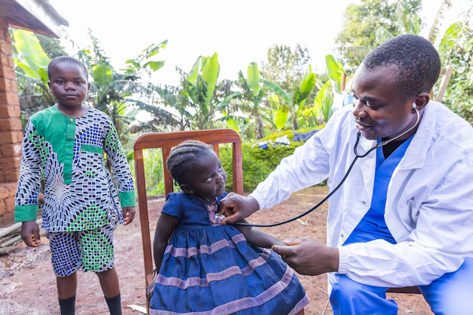
COURSE OBJECTIVE
BY THE END OF THIS TRAINING, PFMOs WILL BE ABLE TO:
  Understand PHC funding mechanisms and the role of BHCPF in improving healthcare services.
  Monitor financial transactions at PHC facilities, identify red flags, and report unauthorized spending.
  Conduct routine facility visits, assess staff presence, medicine availability, and infrastructure, and submit accurate reports.
  Support data collection and verification, ensuring PHC records align with actual service delivery and financial reporting.
  Recognize security risks, personal safety threats, and emergency response protocols when working in the field.

Slide 6




COURSE STRUCTURE
The training is divided into four key modules, each addressing a core function of the PFMO role:
PHC Overview and Interventions
PFMOs’ Roles and Expectations
Financial Management in PHCs
Data Collection and PHC Support
Understanding the Nigerian health system, PHC financing, and relevant interventions.
Identifying PFMO roles and responsibilities, routines, and intervention management structure.
Tracking expenditures, identifying financial mismanagement, and ensuring fund accountability.
Understanding data points and sources, data collection methods, receiving and providing feedback to the PHCs, and maintaining security awareness and safety measures.

Slide 7
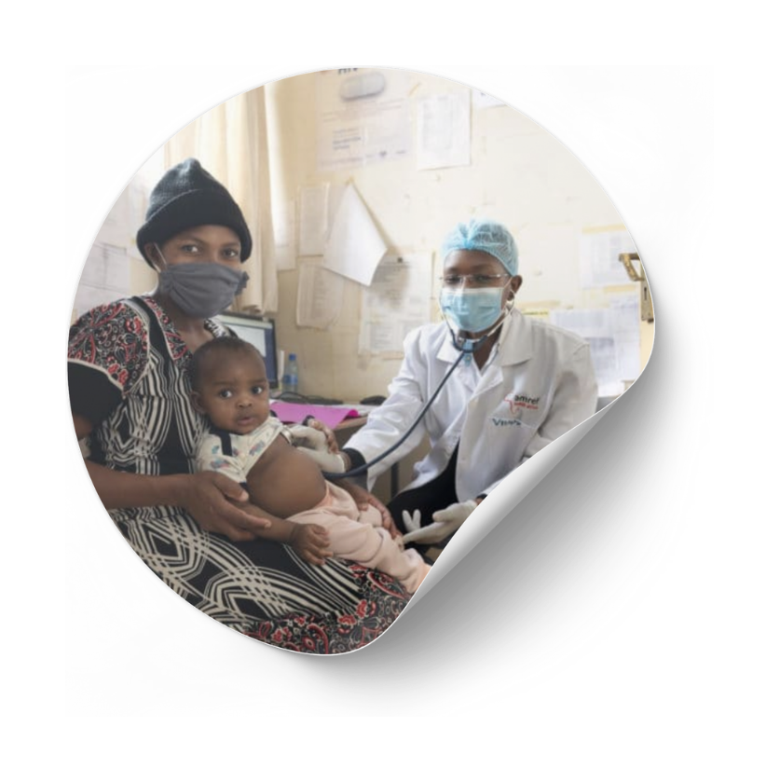

WHY THIS TRAINING MATTERS?
EQUIPPING FOR PHC’s TRANSFORMATION
PFMOs are a critical layer of the BHCPF accountability mechanism, ensuring BHCPF funds are used correctly, and PHCs deliver quality services. With accurate monitoring and timely reporting, they play a vital role in improving healthcare access, preventing financial leakages, and strengthening Nigeria’s PHC system.
By the end of this course, PFMOs will be confident, well-equipped, and ready to fulfill their responsibilities in transforming primary healthcare delivery across Nigeria.

Slide 8


NIGERIA HEALTH SYSTEM (NSHRII, PHC BLUEPRINT)
8

Slide 9
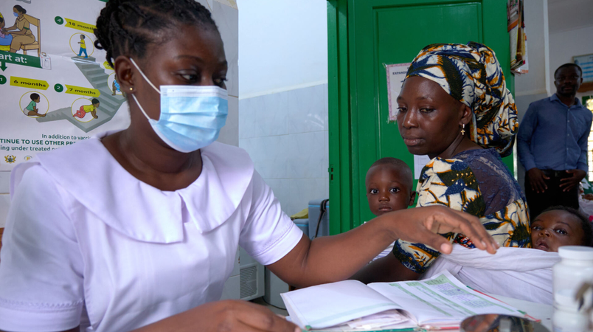

NIGERIA HEALTH SYSTEM (NSHRII, PHC BLUEPRINT)
The Nigeria Health Sector Renewal Investment Initiative (NHSRII) is a major initiative led by the Federal Government of Nigeria under the President Bola Ahmed Tinubu administration, aimed at achieving Universal Health Coverage (UHC) by 2030.
KEY OBJECTIVES
  To ensure that all Nigerians have access to essential health services by 2030.
  Utilize BHCPF to ensure sustainable funding and targeted interventions across the health sector.

Slide 10
A new vision is possible and achievable: Nigeria Health sector renewal investment initiative
01
NIGERIA’S HEALTH SECTOR RENEWAL

Slide 11
NIGERIA HEALTH SECTOR RENEWAL INITIATIVE
The Initiative comprises the BASIC HEALTHCARE PROVISION SECTOR-WIDE APPROACH(BHCP-SWAp) and the HEALTHCARE INDUSTRIALIZATION PROGRAM.
The BHCP will be managed through a sector wide approach via real or notional pooling of all available funds. The Nigeria healthcare industrialization fund will be a specially dedicated pool of funds to drive investment in the healthcare value chain.
Nigeria Health Sector Renewal investment Initiative
Basic Health Care Provision Sector Wide Approach Initiative
NGR INDUSTRIALIZATION FUND
Basic Health Care Provision Fund (BHCPF)
Medical and Public Health Emergencies Fund
Decentralized Facility Financing
Vulnerable Group Fund
Secondary care
Tertiary &
Quaternary
Care
Public
Health
Measures through Community-Based Service Delivery
Medical industrialization
Financing
Private Sector
Commodities
Governance
Data
Digital in health
Human Resources for Health
HEALTH SECURITY
Social Accountability and Citizens Engagement

Slide 12
History of Primary Health Care
Origin:
Primary Health Care started with a declaration by delegations from 134 countries at the 1978 International Conference in Alma Ata, Kazakhstan- reviewed 40 years later at Astana in 2018
This became known as the “Alma Ata Declaration”
The declaration identified primary health care as the key to the attainment of the goal “Health for All by the year 2000”
Although many countries have integrated PHC into their national health care systems, the goal of Health for All by the Year 2000 was not achieved globally.
PHC became a core policy for WHO since 1978 with the adoption of the Declaration of the Alma-Ata
It remains the permanent approach to achieving health for all

Slide 13

Overview of Primary Health Care
Definition
PHC is essential health care based on practical, scientifically sound, and socially acceptable methods and technology made universally accessible to individuals and families in the community through their full participation and at a cost that the community and country can afford to maintain at every stage of their development in the spirit of self-reliance and self-determination-
PHC is usually the first point of contact people have with the health care system. It provides comprehensive, accessible, community-based care that meets the health needs of individuals. bringing health care close to people to where people live and work.
Goal
The ultimate goal of primary healthcare is the attainment of better health services for all- irrespective of place of residence or socio-economic status
Principles
Universal access to care and coverage on the basis of need
Commitment to health equity as part of development oriented to social justice
Community participation in defining and implementing health agendas
Appropriate technology
Inter-sectoral approaches to health
SOURCE: Alma Ata declaration, WHO, Beena 2008

Slide 14
WHAT IS NOT PHC?
  PHC is NOT health care ONLY for the poor. It is for everyone UPPER CLASS, MIDDLE CLASS AND THE POOR.
  PHC is NOT health care ONLY for rural dwellers. It’s for everyone (also includes urban dwellers)
  PHC is NOT just facility based care, it includes community preventive health actions, collaboration with other sectors with the view to improve wellbeing. (e.g. building access road, potable water, “light”, food security etc)

Slide 15








There are eight distinct component of Primary Health Care (PHC)
Health Education
Prevention of Locally endemic disease control
Safe water and basic sanitation
Expanded program for immunization
Treatment of communicable and non-communicable diseases
Maternal and Child Health including responsible parenthood and family planning
-Medical records
- Bio-Statistics
- Care for the elderly
- promotion Mental health
- Dental health
- comm. ENT
- occupational health
Nutrition
Essential drugs
SOURCE: Alma Ata declaration, WHO, Beena 2008

Slide 16







HEALTH SYSTEM ARCHITECTURE AT PHC LEVEL
Ward Development Committees (WDCs[1] ):
These are community-based committees that play a vital role in PHC oversight and community engagement.
They help identify community health needs and work with the PHC staff to address them.
They need to be included in the figure above
Local Government Health Authorities (LGHAs):
LGHAs have the primary responsibility for the management and supervision of PHCs within their local government areas.
State Primary Health Care Development Agencies (SPHCDAs): SPHCDAs coordinate and oversee PHC services at the state level and provide technical support, training, and resources to PHCs.
State Ministries of Health (SMOH): The SMOH provides overall policy guidance and strategic direction for health services in the state, including PHCs.
National Primary Health Care Development Agency (NPHCDA):
At the national level, the NPHCDA is responsible for the overall coordination and development of PHC services in Nigeria. It sets standards, provides technical assistance, and monitors the performance of PHCs nationwide.

Slide 17
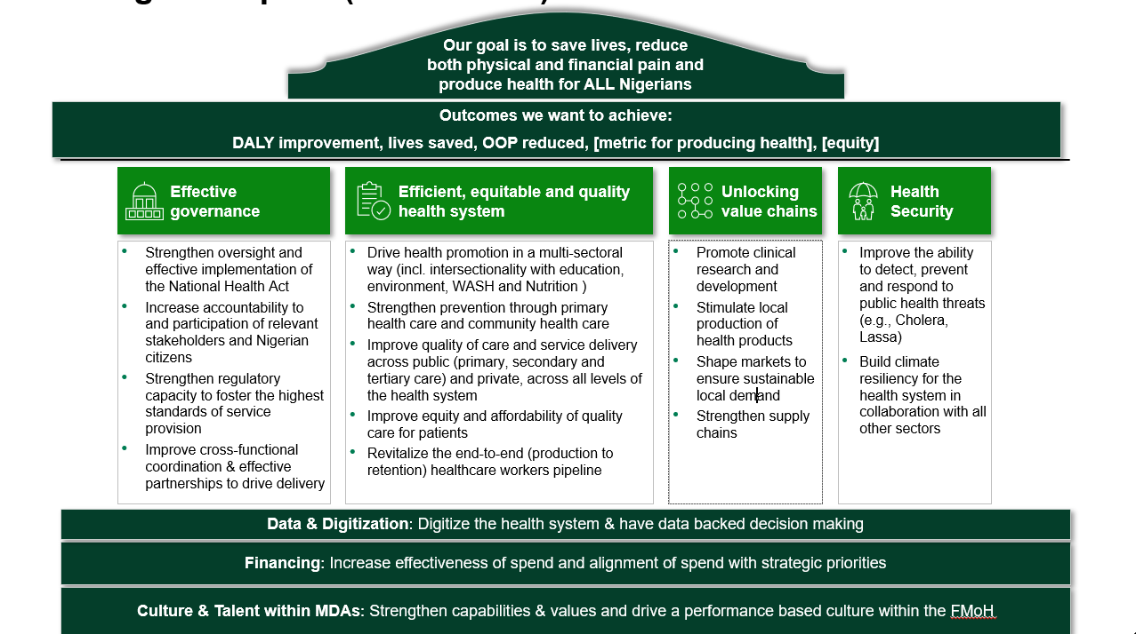
STRATEGIC VISION FOR THE HEALTH SECTOR [2023-2026]
Notes:
Delivering a health agenda for Nigeria is thus a matter of the utmost importance for Nigeria, the subregion, and the world.

Slide 18


UNDERSTANDING PRIMARY HEALTH CENTERS (PHCS) IN NIGERIA
Primary Health Care (PHC) is the foundation of Nigeria's healthcare system, ensuring that everyone can access basic health services. However, challenges like low funding, poor transparency, and unfair service distribution have weakened PHCs in many areas.
Primary Health Center (PHC)
A Primary Health Center (PHC) is the first-place people go for healthcare in Nigeria.
It provides basic and affordable health services close to where people live and work. PHCs focus on preventing diseases, promoting good health, and treating common illnesses.

Slide 19
Based on the reforms, PHC Facilities are now classified according to functionality
TYPES OF PHCs IN NIGERIA
Partially functional
Functional Level 1
Functional Level 2
Description
  Provide some services but not meet the functional L1 criteria
“Capable of providing antenatal and immunization services”
“Everything in place for a pregnant woman to deliver a baby safely 24/7”
Tracer services
  Antenatal care and
  Routine immunization
  Level 1 tracer plan (ANC and RI) and
  Facility-based deliveries
Functionality criteria
HRH and staff accommodation
  1-3 SBAs
  4 – 6 SBAs with accommodation
  OR
  >6 SBAs (without accommodation)
Infrastructure¹ (Power)
  Access to primary power source
  24/7 access to reliable power supply and back up solar power
  WASH Facilities

Slide 20

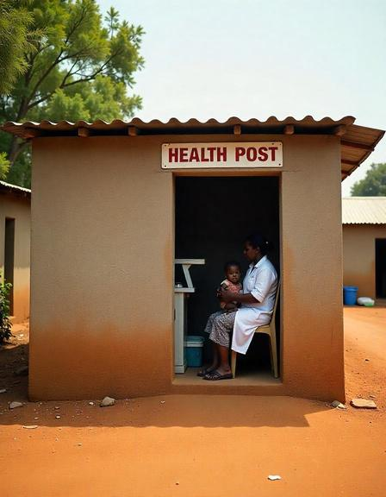
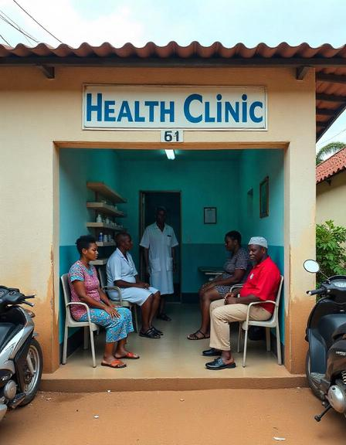
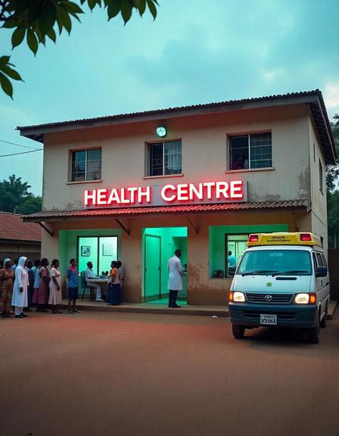
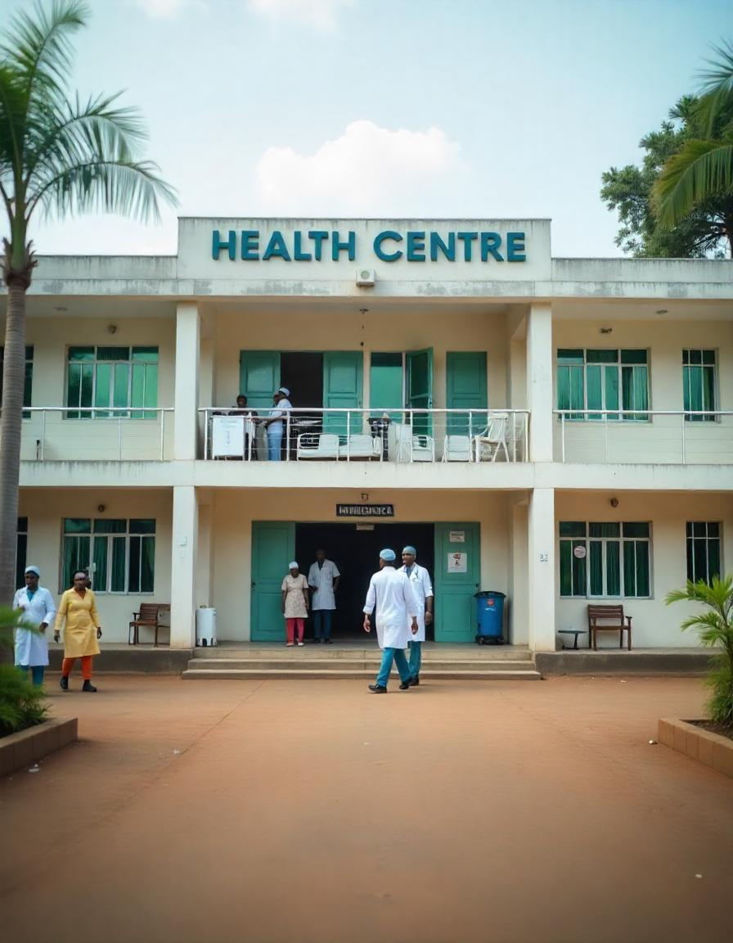
TYPES OF PHCs IN NIGERIA
Use real picture from Google
Health Posts
Health Clinics
Health Centers
Comprehensive Health Centers
While services may vary based on location and available resources, PHCs typically provide a core set of essential services as described in subsequent slides

Slide 21

TYPES OF PHCs BY SERVICE OFFERING
Primary Health Care Centre L1: Minimum Pack
There are three levels of Primary Health Care Centres:
These core services are provided by all PHCs and typically include:
Primary Health Care Centre Level 1
Primary Health Care Centre Level 2
Primary Health Care Centre Level 3
  ANC and PNC
  Immunization
  Infant and young children feeding
  Case management of childhood illness
  Screening for communicable diseases (e.g TB and HIV)
  Screening for non-communicable diseases (e.g goitre, diabetes, and hypertension)
These facilities may have the same physical infrastructure, but the main differences are the human resource availability and the services they provide.
Level 1 PHCs are staffed with CHEWs, they do not provide 24-hour services and it is expected that states will provide the health system support to quickly upgrade these centres to a minimum level 2 PHCs.
Level 2 PHCs have CHEWs and at least one midwife and are open for 24 hours. They provide the “Intermediate PHC Pack” of Services.
Level 3 PHCs should have CHEWs and at least 2 midwives and are also open for 24 hours. They provide the “Optimal PHC Pack”.

Slide 22
TYPES OF PHCs BY SERVICE OFFERING
Primary Health Care Centre L3:
Optimal PHC Pack
Primary Health Care Centre L2:
Intermediate Pack
  ANC and PNC
  Delivery Services
  Basic Emergency Obstetrics and Newborn Care
  Immunizations
  Infant and young children feeding
  Case management of childhood illness
  Screening for Communicable Diseases
  Treatment of CDs and NCDs
The main difference between this facility and a Level 1 facility is that in addition to provision of the minimum health care pack, they provide delivery and basic emergency obstetric and newborn care services:
  ANC and PNC
  Delivery Services
  Basic Emergency Obstetrics and Newborn Care
  Immunizations
  Infant and young children feeding
  Case management of childhood illness
  Screening for Communicable Diseases
It is ideal for each ward to have at least one PHC centre of Level 3 classification, termed the Ward Focal PHC Centre. This focal PHC centre serves as the hub for all PHC service points in the ward (the apex referral facility).

Slide 23







HRH for PHC
Doctors/
Medical Officers
Nurses/
Midwives
CHOs & CHEWs
Diagnose, treat, and manage illnesses
Provide nursing care, administer medications, and support maternal and child health
Bridge PHCs and communities, offering health education, outreach, and preventive care.
Staffing shortages are a major issue, with many PHCs relying on CHEWs to provide essential services in the absence of medical officers.
Pharmacists/
Technicians
Lab Technicians
Support Staff
Dispense medications and offer drug-use counseling (not always available)
Perform basic lab tests (not always available)
Handle records, cleaning, and security.

Slide 24
Skilled Birth Attendants (SBAs): WHO definition
Accredited health professionals (e.g., midwives, doctors, nurses) proficient in managing normal pregnancies, childbirth, immediate postnatal period, and identifying/managing/referring complications in mothers and newborns.
L2 facilities require a "required complement of skilled staff" including SBAs.
An L2 PHC, which offers more advanced care including basic emergency obstetric and newborn care (BEmONC), is required to have a minimum of four (4) Skilled Birth Attendants (SBAs) on staff. Among these, at least one must be a qualified midwife, capable of managing normal deliveries and identifying complications that require referral to higher levels of care. This staffing ensures that the facility can provide 24/7 maternity services and effectively handle deliveries and obstetric emergencies.
On the other hand, an L1 PHC, which provides more basic maternal health services, is required to have between one (1) and three (3) Skilled Birth Attendants. Similar to L2, at least one of these SBAs must be a qualified midwife, ensuring that every L1 PHC has the capacity to provide safe delivery services and essential newborn care.
Task Shifting:
Delegating specific healthcare tasks, where appropriate, to health workers with shorter training and fewer qualifications to optimize the use of available human resources.
Utilized in PHC facilities, including L1 and L2, alongside qualified Nurse/Midwives to ensure adequate staffing.

Slide 25







GOVERNMENT FUNDING
HOW ARE PHCS FUNDED?
Federal, State, and Local Governments contribute, with BHCPF playing a key role in strengthening PHCs through budget allocations
NHIA
Expanding coverage helps finance PHCs through payments for services rendered
Government Funding including BHCPF
Foreign Aid
DONOR FUNDING
Organizations like WHO, UNICEF, and the Gates Foundation support maternal health, immunization, and disease control programs
PHC funding in Nigeria is a shared responsibility under PHCUOR
OUT-OF-POCKET PAYMENTS
Private Sector Funding
Insurance
Some PHC services require user fees, creating barriers where community health insurance is lacking
PRIVATE SECTOR FUNDING
Contributions include private insurance, corporate social responsibility programs, and partnerships with healthcare providers
Out-of-Pock Payments
Donor Funding
FOREIGN AID
Agencies like USAID and DFID provide targeted funding for healthcare programs and sector-wide support

Slide 26
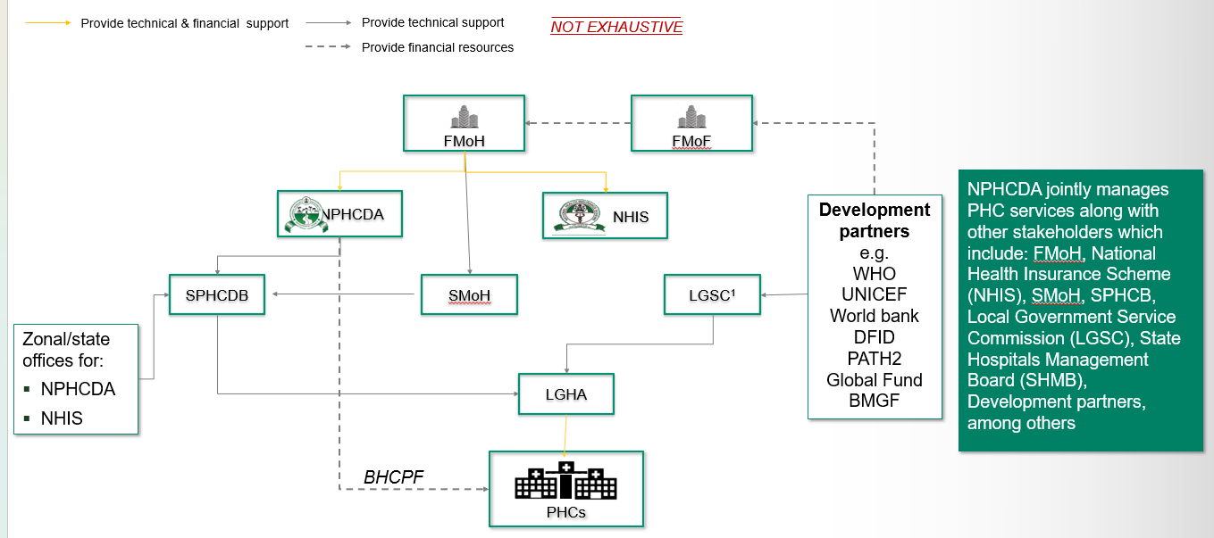

HOW ARE PHCS GOVERNED?
The governance structure of PHCs involves multiple levels:
The NPHCDA's core mandate is to strengthen Nigeria's primary healthcare system by ensuring equitable access to essential health services, promoting immunization, and coordinating national health programs.

Slide 27
Sub-Section
Current PHC Initiative
PHC Revitilization
Mainii
HOPE PHC
Other interventions
HIV
Malaria
etc.
BHCPF & IMPACT (details later)
}1 Slide Each
}mentions

Slide 28


PHC REVITALIZATION
Nigeria's PHC has faced persistent challenges, limiting optimal care delivery. In response, the government has launched a PHC revitalization initiative, reaffirming the Presidential commitment on health to making healthcare more accessible, affordable, and effective for all Nigerians through NHSRII and PHC Blueprint.

Slide 29
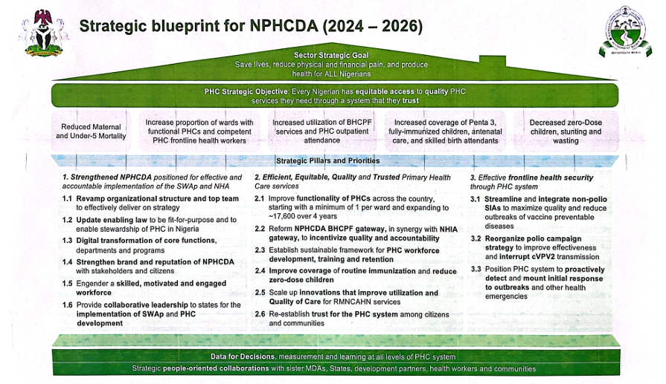

Slide 30

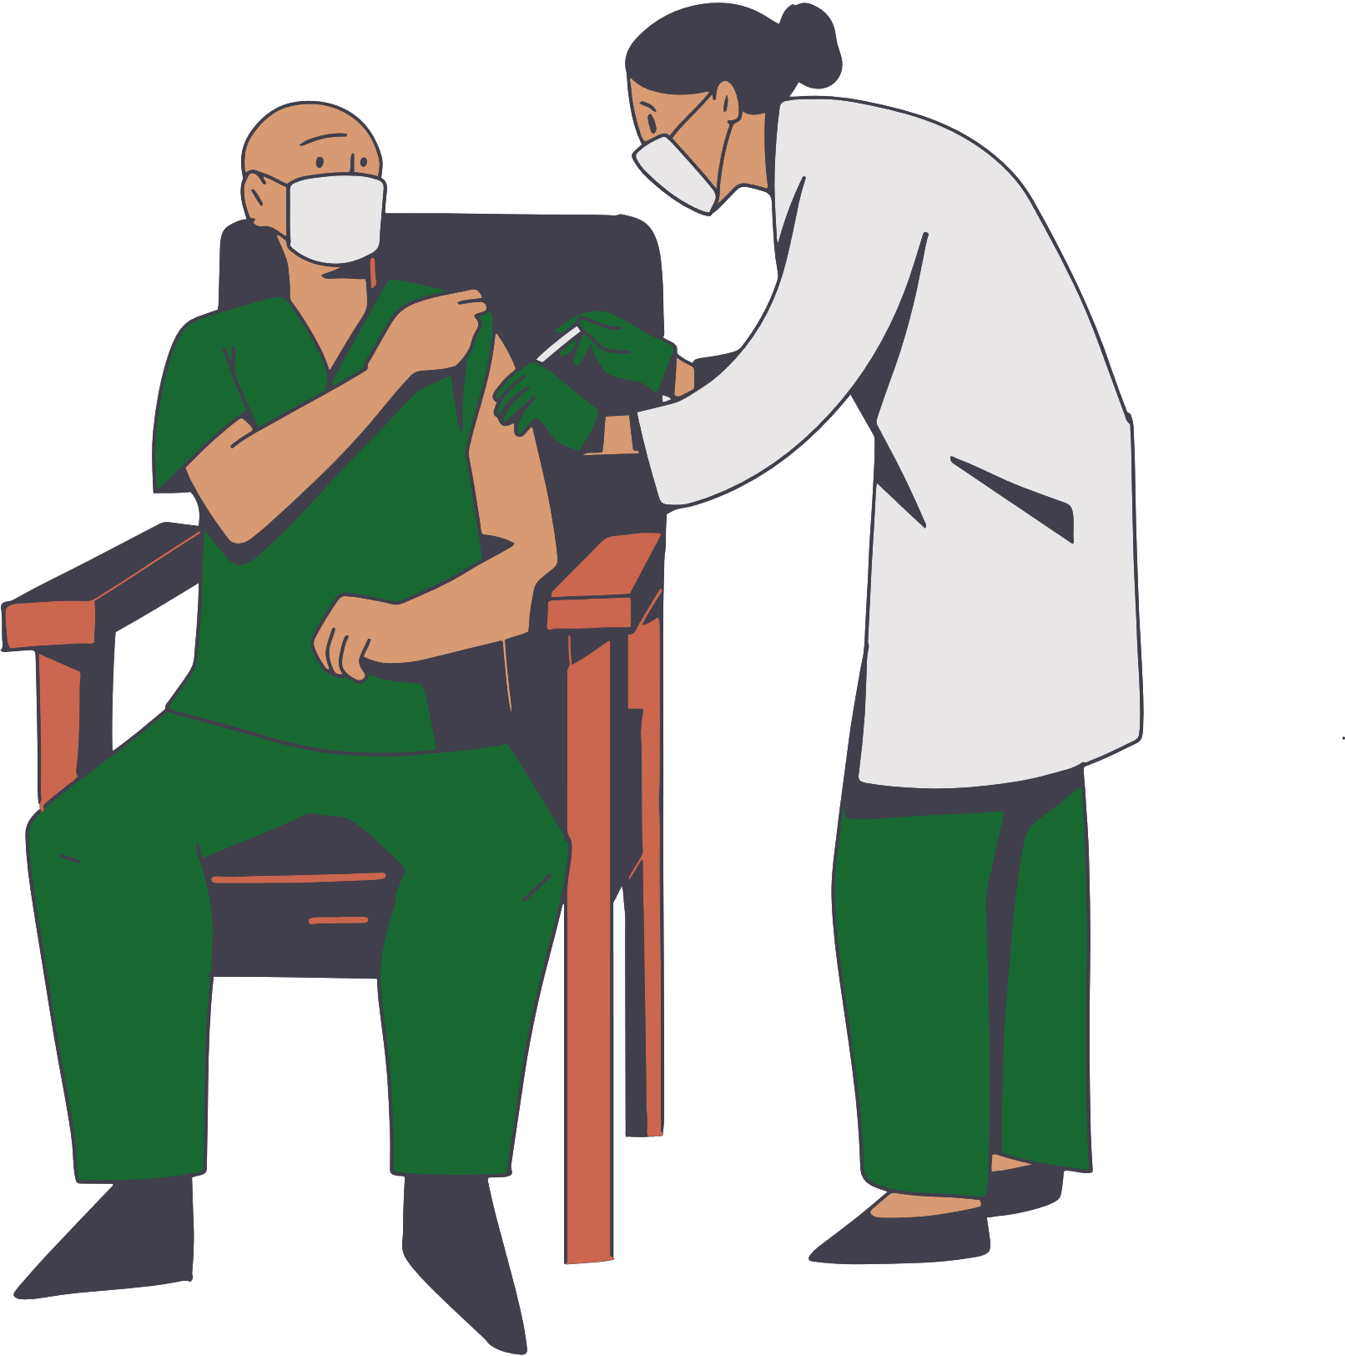



WHAT IS PHC REVITALIZATION
PHC revitalization is a structured process to enhance quality, accessibility, and utilization. It strengthens all key PHC system components, including:
Service Delivery
Human Resources
Infrastructure
Supply Chain
Expand services, improve quality, and integrate care to address community health needs.
Recruit, train, and support healthcare professionals for equitable distribution and effective service.
Upgrade PHC facilities with national grid and solar back up, water, and sanitation for better service delivery.
Strengthen logistic and distribution to ensure continuous availability of medicines and vaccines in front line PHC.

Slide 31




WHAT IS PHC REVITALIZATION
Financing
Information Systems
Governance & Leadership
Community Ownership
Diversify funding sources and enhance financial management for sustainability.
Improve data collection and analysis for better planning and evaluation.
Enhance management structures and encourage community participation.
Involve communities in PHC planning and monitoring to ensure responsiveness to local needs.

Slide 32
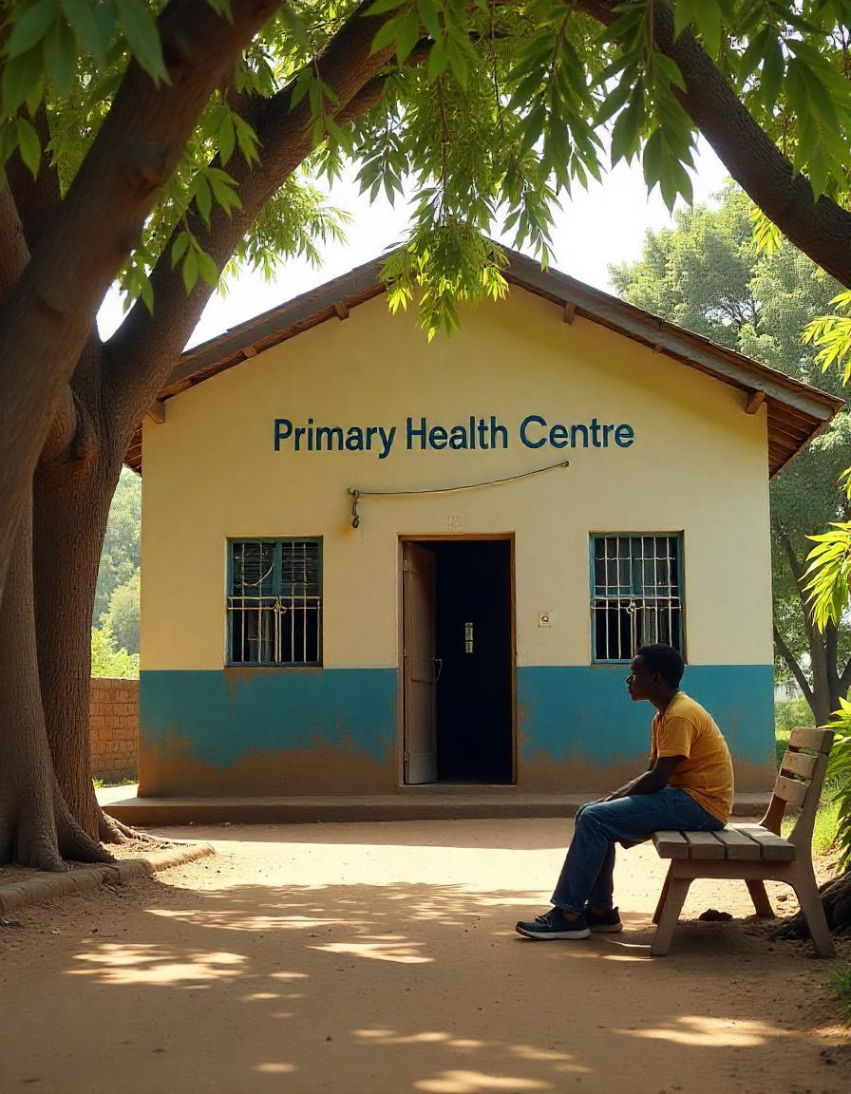





WHY IS PHC REVITALIZATION IMPORTANT
PHC facility is platform for quality service delivery in facility and outreaches
Improved Health Outcomes
A strong PHC system leads to improved maternal and child health, reduced burden of infectious diseases, better management of chronic conditions, and increased life expectancy.
Reduced Healthcare Costs
By addressing health issues at the primary level, PHC can prevent more costly hospitalizations and interventions at higher levels of care.
Equity and Access
PHC can improve access to healthcare for marginalized and underserved populations, reducing health disparities and promoting health equity.
Universal Health Coverage
PHC is the foundation of UHC, making quality healthcare accessible and affordable for all.
Economic Development
A healthy population contributes to increased productivity and economic growth.

Slide 33
PHC Revitalization: Progress as of 30th April 2025 (based on reported data on tracker)
WIP
National funding sources
Partner/ Private sector
State Government / Partner joint funding sources
Number of facilities proposed for revitalization*
1. BOQ cleared by NPHCDA / Partner
3. PHC Revitalization work ongoing
4. PHC revitalization work completed
Total
3,624
2,717
996
National Funding¹
331
331
173
33
Solar Power Intervention
72
72
9
14
Solar Borehole Intervention
71
71
11
-
IMPACT / BHCPF for States²
3,373
3,110
1,875
156
State Funds⁴
-
-
587
698
Private Sector³
387⁵
-
17
48
Global Fund
200
40
18
16
Other Partners⁶
-
-
27
31
UNICEF – Solar Power
418⁷
-
-
-
1. Includes: Constituency Projects, Other NPHCDA appropriations budget, intervention Funds, Funding from Large Anonymous donors, The Susan Thompson Buffet Fund // 2. Projected numbers for revitalization based on available funding and ballpark estimates // 3. Private sector direct investment into PHC facility upgrade mainly through PSHAN // 4. State government funds based on self reports // 5. Minimum of 387 projected for 2027 based on PSHAN’s target of 774 (1 per LGA) by 2032. 6. Sokoto State WB FADAMA (19), PLAN International (8), GAVI/UNICEF – Bayelsa (10), UNICEF PHC Challenge – Jigawa (7) 7. UNICEF Solarization (371 from GAVI CDS and 47 CRIBS)
* - Proposed number based on available funding at the start of the process

Slide 34

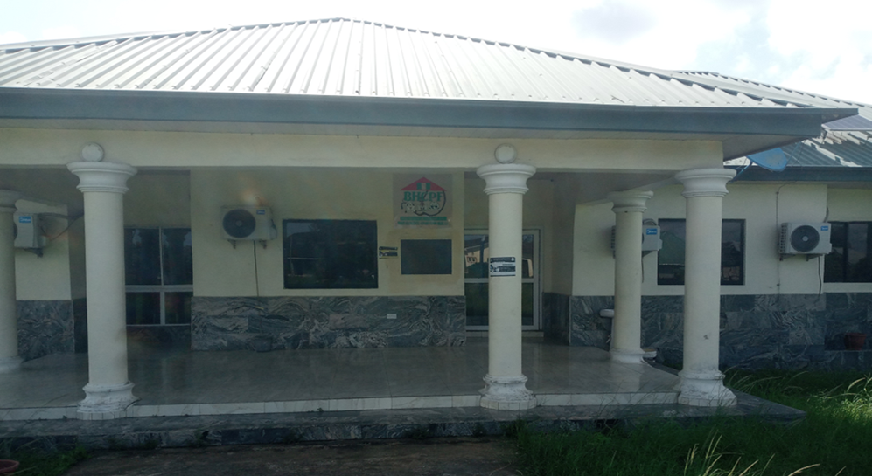
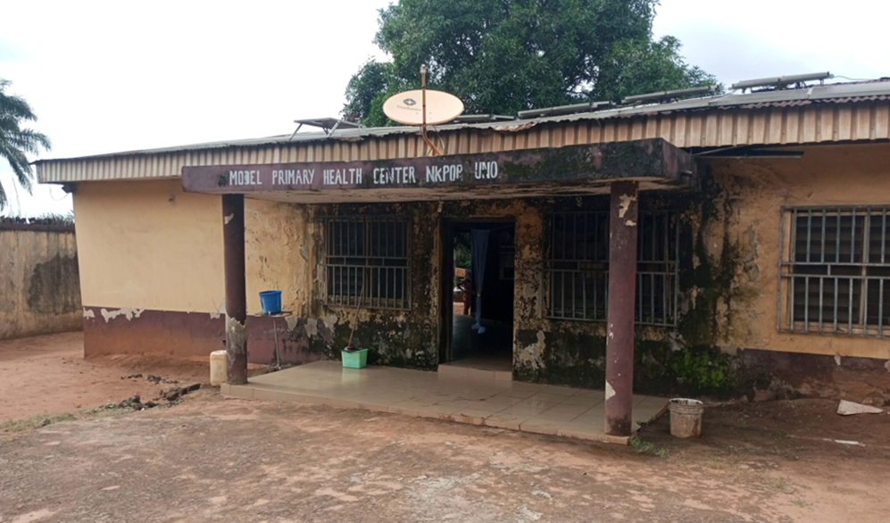
THE JOURNEY OF PHC REVITALIZATION IN NIGERIA
  Nigeria's journey towards PHC revitalization has involved various policies, strategies, and initiatives, including the National Health Policy, the National Strategic Health Development Plan, and the Basic Health Care Provision Fund (BHCPF).
  The BHCPF, in particular, is a landmark initiative aimed at providing sustainable funding for basic health services, with a significant portion earmarked for strengthening PHCs.
VS
Image 1: Sample of a well-maintained PHC facilities
Image 2: Sample of a poorly maintained PHC Facilities

Slide 35



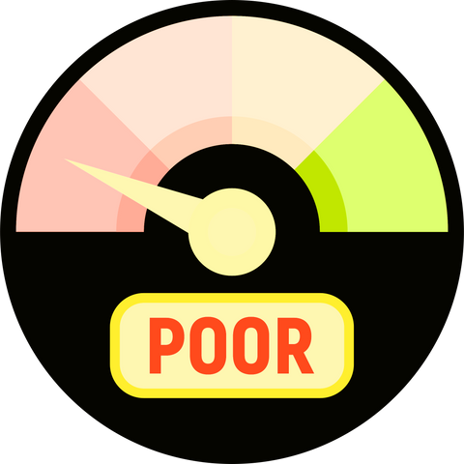

Dilapidated buildings – Leaking roofs, cracked walls, and poor ventilation
COMMON CHARACTERISTICS OF POORLY MAINTAINED PHC FACILITIES
Lack of basic amenities – No clean water, electricity, or functional toilets.
Poor equipment maintenance – Broken medical tools, outdated or non-functional diagnostic equipment.
Limited availability of essential drugs – Frequent stockouts of medications and vaccines

Slide 36

INTRODUCTION TO BHCPF, SIGNIFICANCE AND FOCUS OF PFMO INTERVENTION
(Overview of the PHC funds (DFF, Capitation, other sources)

Slide 37
Introduction To The National Health Act (NHAct, 2014)
The National Health Act (NHAct) 2014 was enacted to ensure improved health outcomes, by providing a legal framework for the provision of health care services and establish an organizational and management structure for the health system in Nigeria.
Section 11, NHAct of 2014, mandates the establishment of a Basic Health Care Provision Fund (BHCPF) as a catalytic funding for the transformation of PHC in Nigeria
The Act is a milestone in the national momentum to strengthen the primary health care system, improve health indices and move Nigeria towards achieving Universal Health Coverage (UHC) with the consequential improvement in economic productivity.
BHCPF is to support the effective delivery of primary health care services, provide insurance coverage through the provision of a Basic Minimum Package of Healthcare Services (BMPHS) and to address both Medical and public health Emergencies.
Source:

Slide 38
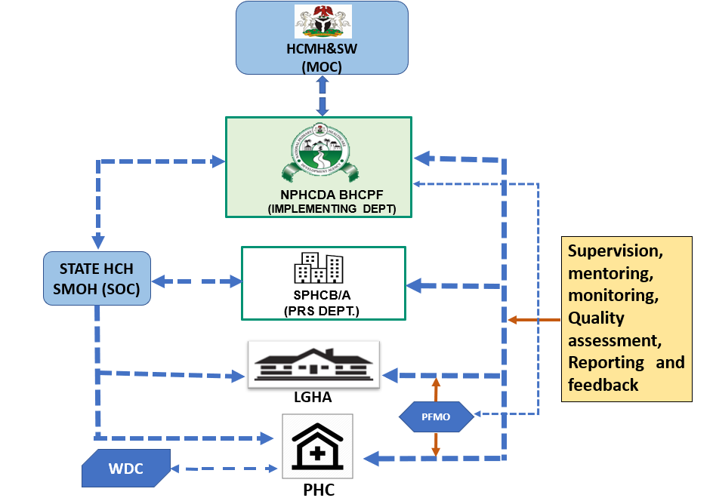
The Governance Structure for the implementation of the NPHCDA Gateway
The 4 operational level of the Institutional Structure reflecting the PFMOs

Slide 39
Implementation Cycle of the NPHCDA Gateway At facility level
Quarterly Fund Release For Approved Plans
SPHCB
Quarterly Verification
LGHA
START
Quarterly Financial Report/retirement
Annual Q.I. Plan
Quarterly Business Plan
Provide BMHSP & Implement
Q.I Activities
PHC
Monthly Expenditure Plan
Activity Process/Reporting
Supervision
SOURCE: Team analysis, BHCPF guideline

Slide 40
Overview Of NPHCDA Gateway (1/2)
  In line with the National Health Act 2014, The NPHCDA Gateway manages 45% of the funding to provide support for human resources for PHC manage at the state level and decentralized facility financing (DFF) to meet operational cost at the PHCs. , these includes:
    Provision of essential drugs, vaccines and consumables;
    Provision and maintenance of facilities, equipment and transport;
    Community outreaches
    Human resource development
The NPHCDA Gateway works in close synergy with the NHIA Gateway to facilitate the delivery of quality PHC services:
      Pooling of DFF and Capitation earned under the NHIA Gateway by the BHCPF PHC in a single commercial bank account
      Address the Community’s health needs by keeping the PHC functional, Providing a Basic Minimum Package of Health Services (BMPHS), outreaches, community engagement and health education etc

Slide 41
Overview Of NPHCDA Gateway (2/2)
The NPHCDA have worked in collaboration with FMOH, NHIA and Partners in supporting states to meet readiness criteria for commencing BHCPF Implementation, these include
  Establishment of state Governance structures SPHCDA/Bs
  Opening of state TSA accounts; in order to receive state BHCPF allocations
  Baseline assessment of facilities and Capacity building of health workers and verification exercise with state; prior to authorization for DFF funds to be transferred to facilities
NPHCDA undertakes the verification process to ensure the PHCs have the minimal requirements to receive DFF and provide quality services
Requirements include; minimal clinical staff, fair infrastructure etc.
PHCs not meeting the above are identified, and the state motivated to fix the issues before they are approved to receive DFF

Slide 42
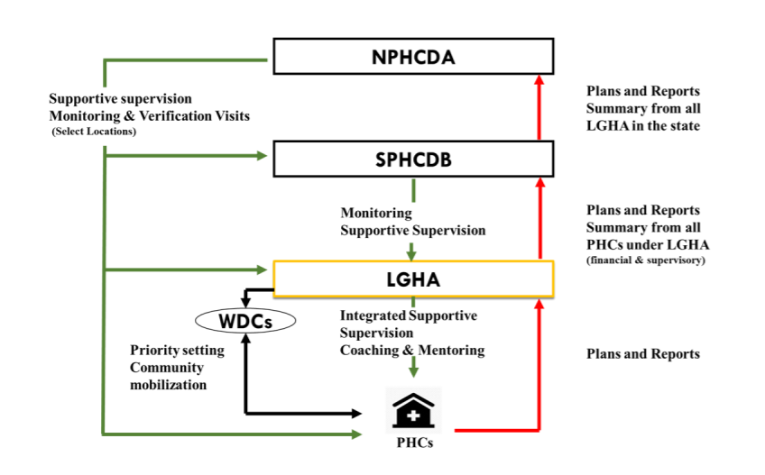
NPHCDA Gateway coordination structure
The ES SPHCB is responsible for implementing the NPHCDA gateway at the state level.
Various activities under the NPHCDA Gateway are driven by existing departments and Units in SPHCB
Implementation under the NPHCDA Gateway is coordinated through the PRS Department of the SPHCB.
The PRS department also ensure seamless communication and collaboration with the NPHCDA BHCPF Program Implementation Unit (PIU).
Monitoring & Supervision
Reporting
Oversight, supervisory and monitoring activities under the NPHCDA Pathway flows from the NPHCDA downwards and activity planning and implementation are reported upwards from PHCs
Notes:
Flow of authority and responsibilities under the NPHCDA Gateway

Slide 43

NPHCDA Gateway Process Map
MOC
National
MOC
Provides oversight to the Gateway under the leadership of HMH
NPHCDA
Disbursements of funds to SPHCBs
Supervision, monitoring, quality assessment.
Reporting and Feedback Pathway
Oversight
NPHCDA
BHCPF PIU
Supervision, Monitoring, quality assessment.
Reporting and Feedback Pathway
Programmatic & Operational fund
Workplan
Retirement
State
SPHCB
SPHCB
Approval of annual QIPs, quarterly BPs and retirement from facilities
Disbursements of DFF to facilities
Supervisory visits and quality assessments to facilities
LGHA
Collation and review of annual QIPs, quarterly BPs and retirement from facilities
Supervisory visits and quality assessments to facilities
PHC
Development of annual QIPs, quarterly BPs and retirement from facilities
Service delivery
Annual QIP summary
Quarterly BP summary
Quarterly retirement summary
Supervisory visits
Quality assessments
LGA
DFF
Annual QIP
Quarterly BP
Quarterly retirement
Supervisory visits
Quality assessments
WDC
PHC
Service delivery

Slide 44



Key Reforms for NPHCDA Gateway
2 tiered DFF payments of 800K and 600K per facility per quarter to be used for the provision of essential commodities, utilities, maintenance of facilities and community engagement
Offer services covering Antenatal care, Childbirth, Postnatal care, Family planning, Nutrition, Management of childhood illnesses (malaria, fever, etc), screening of NCDs – hypertension and diabetes, HIV/TB services and Immunization
Harmonize NPHCDA service package with NHIA covered services
Pay performance incentives to PHCs based on utilization and quality of care metrics
PHCs
Increase operational budget from 5% to 10% for enhanced fiduciary oversight
Increase the operational budget from 5% to 15% for intensified monitoring and LGA supervision
NPHCDA
SPHCDAs
Programmatic
Allow for needs-based flexibility of cadre of clinical staff hired at state level that meet minimum certification requirement
Track key metrics at PHCs such as ANC attendance, facility based delivery, eligibility of retirement documents, medical commodity availability and functionality for performance and consequence management
Prioritize facility revitalization and amount using a data-driven and needs-based approach together with States and NPHCDA
Operational
Digitize the process steps to access funds to improve efficiency
Enforce timely quarterly disbursement of funds in line with BHCPF guidelines
Roll over unused funds at NPHCDA /state levels until conditions for use are met
Fiduciary
Utilize PFMOs to cover program performance and financial management with clear ToR
Enforce a dedicated BHCPF TSA sub-account for SPHCDAs
Set 10% cash withdrawal cap for PHCs
Ensure an annual statutory audit is done across all levels (i.e. NPHCDA, SPHCDA, and PHCs)

Slide 45
LGHA Operations
LGAs to directly, participate, mentor and supervise process of developing annual quality improvement plans and quarterly business plans
LGHA would verify and collate PHCs plans and transmit to SPHCBs
They will also be responsible for ensuring that business plans developed by facilities are in adherence to the annual quality improvement plans
They will be responsible for monthly integrated supportive supervision to states
They will be responsible for collating and reviewing retirements from facilities, and transmitting to SPHCBs

Slide 46
PHC Operations (1/2)
Operate bank account
  Current account
  4 signatories (OIC/Deputy OIC and WDC Chairman/WDC Treasurer)
  Ensuring payments by transfers
Develop Annual Quality Improvement Plans (QIP), Quarterly Business Plans
Transmit QIP and Business Plan to LGA-SPHCB-NPHCDA

Slide 47
PHC Operations (2/2)
Introduction
Received Funds
  Quarterly operational funds (NPHCDA Gateway); Capitation (NHIA Gateway); Any additional funding or donations (Community, State, Partners)
  Proportionate funding sanction if QI target not meet
Provide Services to Clients (BMHSP) and Implement QI activities
  PHCs would be encouraged to provide all services free
  Implement QI plan to improve quality score across 10 indicators
Routine verification exercises
  Monthly mentoring and ISS by LGHA; Quarterly verification by States
  Quarterly counter-verification and monitoring by NPHCDA

Slide 48
INTRODUCTION to BHCPF CRITICAL REFORMS (BHCPF 2.0)
BHCPF 2.0 is part of the health sector wide reforms of the current Administration.
Fundamentally recognize the BHCPF and by extension the NPHCDA Gateway in charting ways to achieving the PHC components of the Presidential Commitment to PHC under the Nigeria Health Sector Renewal Investment Program (NHSRIP) implemented using the sector wide approach (SWAp).
To effectively re-position the NPHCDA Gateway, critical reforms have been introduced within the Gateway.
The reforms refocus the Gateway from its prior input-based orientation to an output and performance-based system that incentivizes results.
The reforms are mainly centered on strengthening fiduciary process for accountability and visibility, performance tracking and expanding physical access to quality PHC services by increasing the number of functional PHC facilities across Country.
The revised Guideline for the NPHCDA Gateway is based on these reforms.

Slide 49




Under the new reforms of BHCPF 2.0, The NPHCDA Gateway fund is further structured into four (4) components
Fund Allocation
Programmatic fund
Operational Fund
Comprises of HRH and DFF components which will now be disburse quarterly to state and onward to PHCs
Comprise of overhead funds derived as percentage of national and Subnational levels funding to improve daily management and oversight of BHCPF implementation particularly LGHA supervision and mentoring of PHC (10% and 15% for National and State respectively)
Fund Allocation
PHC Revitalization Fund
Performance based incentive fund
This will be based on need and and availability of funds which will be determined annually after all the annual funding requirement of the Gateway has been fulfilled
PHC facilities will earn quarterly performance-based bonus payment based on scores derived from the quarterly evaluation of the key performance indicators (KPIs)

Slide 50
The Direct Facility Financing (DFF) component which account for 26.71% of BHCPF will now be tiered For equity consideration and effective performance-based funding under the gateway, the BHCPF PHC facilities are to be classified into 2 DFF tiers:
Programmatic Fund- DFF component
1
2
HIGH TIER DFF
LOW TIER DFF
These category of BHCPF facilities will receive higher DFF disbursement
PHC utilization rates at or above the 75th percentile, measured against its peers at a state level and level of functionality will be used to classify facility as ‘High Tier’
Quarterly DFF for this Tier is ₦800K
The low Tier BHCPF facilities will receive lower quarterly DFF disbursement
PHC utilization rates below the 75th percentile, measured against its peers at a State level, will be considered as ‘Low Tier’
Low tier facility will receive quarterly DFF at ₦600K
The quarterly DFF amount to be received by each tier shall be determined bi-annually based on data evidence and adequacy of the funding under the NPHCDA Gateway.

Slide 51



Under BHCPF 2.0 the HRH component will now be flexible based on needs at the state level in terms of the of HRH cadre of clinical staff hired, percentage usage as well as the community-based workers programme
Programmatic Fund- HRH Component
Skilled Birth Attendent (SBA)
1
Not less than 50% of this fund to be used for engagement of SBAs
7.7% of the BHCPF the Development of Human Resource for Primary Healthcare
Community Based workers
2
Not more than 50% for community based workers programme currently undergoing redesign
Task shifted CHEWs that Undergoes MLSS training can now be engaged as SBAs in the absence of midwives under the new reforms
Source: Team analysis

Slide 52



BHCPF Facilities will earn a discretionary Performance based incentives up to Maximum 10% of their DFF quarterly on fulfilling key KPIs scores
Performance based incentive Fund
Focus
Indicators
Data Source
Frequency
Weight (%)
Utilization used for DFF to ensure needs-based financing
To ensure facilities are incentivized to maximize utilization, utilization as a % of a target will be incorporated into the performance bonus
In parallel, to mitigate incentive to push quantity over quality, performance bonus will be linked to quality-of-care metrics
To maximize intended impact of incentives, minimum threshold of 60% could be set for PHC to become eligible for incentive bonus
Utilization³
Number of ANC 1 visits
DHIS 2
Monthly/Quarterly
5%
Number of Facility -based Deliveries
DHIS 2
Monthly/Quarterly
5%
Number of Penta 1 administered
DHIS 2
Monthly/Quarterly
5%
Quality of care
Retention of care
Proportion of pregnant patients with 4 ANC visits
DHIS 2
Monthly/Quarterly
15%
Proportion of children that receive Penta 3
DHIS 2
Monthly/Quarterly
15%
Outcomes
% decrease in facility-based maternal mortality rate
DHIS 2
Annually⁴
20%
% decrease in Under 5 mortality rate
DHIS 2
Annually
20%
Patient feedback
Patient satisfaction survey score (%)
Outpatient survey
Monthly/Quarterly
5%
Facility functionality
HRH presence, on register and on ground, against state register
PFMO¹
Monthly/Quarterly
5%
Improvement in number functional equipment from a 0-baseline
PFMO
Monthly/Quarterly
5%
1. Performance and Financial Management Officers (while digital systems deployed)
2. Minimum number required to meet the full score for the performance metrics
3. Compared against target utilization
4. Latest available outcomes score to be used for disbursement purposes; Example: if a PHC's outcome score was determined to be 15%, this will remain constant and used for subsequent disbursements, till the next measurement is done, while all other metrics are updated for each disbursement cycle.
Notes:
Fiduciary metrics
Is your reporting on time
Is your report accurate?
Is your spending compliant for use of funds– this needs to be introduced as a #3
For Utilization and QoC – there are 3 services we are trying to track performance of:
Immunization services – Penta 1
ANC services – Number of ANC 1 visits
Delivery services – Number of facility-based deliveries
For QOC – there are subcategories as well that also tie to the 3 above:
1. Retention of care – Proportion of pregnant patients with ANC 4 visits, Penta 3
2. Process of care - TBD
3. Outcomes - % decrease in facility based maternal mortality rate
4. Patient feedback – Outpatient feedback

Slide 53
Financial Management Processes
In any functional financial management system, there are three important processes that must take place for such a system to be effective
Funds retirement
03
Funds disbursement
02
Budgeting
01

Slide 54






The BHCPF funds healthcare through government grants, and donations, focusing on maternal health, immunization, and emergencies.
PFMOs ensure proper fund use by:
Tracking expenses and checking receipts.
Reporting and addressing misuse.
Monitoring spending and verifying records
Monitor, transmit, relay feedback and track progress
They collaborate with officials to maintain transparency and improve healthcare, especially in underserved areas.

Slide 55
BHCPF FINANCIAL AND OPERATIONAL GUIDELINES
Objectives of BHCPF
1/2
  Establish at least one fully functional PHC per political ward (30% in 3 years, 70% in 5 years, 100% in 7 years).
  Ensure each state has at least three operational secondary healthcare facilities, supported by BHCPF (50% of states in 3 years, 100% in 5 years).
  Implement a national ambulance service and emergency response system in all 36 states and the FCT within 5 years.
  Reduce out-of-pocket healthcare expenses by 30% in 5 years through expanded health insurance coverage.
  Increase life expectancy to at least 60 years within the next decade.
Nigeria's Basic Health Care Provision Fund (BHCPF) has financial and operational guidelines detailing its funding sources and criteria for state participation.

Slide 56
BHCPF FINANCIAL AND OPERATIONAL GUIDELINES
2/2
Funding
Operational guidelines
Financial guidelines
  The BHCPF is primarily funded by an annual grant from the Federal Government of Nigeria.
  The grant is at least 1% of the Consolidated Revenue Fund (CRF).
  The BHCPF also receives funding from international donors and other sources, such as taxes on alcohol and cigarettes.
  States and local governments are expected to contribute 25% of the funding for PHC projects
  States must meet specific criteria to be eligible for the BHCPF, such as:
    Baseline assessment of BHCPF health facilities
    Capacity building for health workers
    Verification of implementation at the state level
  BHCPF funds PHCs for operational costs, medicine procurement, and service delivery.
  PHCs are expected to be reimbursed for monthly expenses by the NHIS Gateway.
  The National Steering Committee of the BHCPF prepares financial statements for the project.
  The financial statements must accurately reflect the project's financial position.
  The National Steering Committee is responsible for safeguarding the project's assets and preventing fraud.

Slide 57

CONCLUSION
Strong Primary Health Care (PHC) is key to keeping people healthy and improving Nigeria’s healthcare system. This module explained how PHCs are organized, funded, and managed. It also showed why the Basic Health Care Provision Fund (BHCPF) is important and how Performance and Financial Management Officers (PFMOs) can help to ensure PHCs use their funds properly and provide good services.

Slide 59
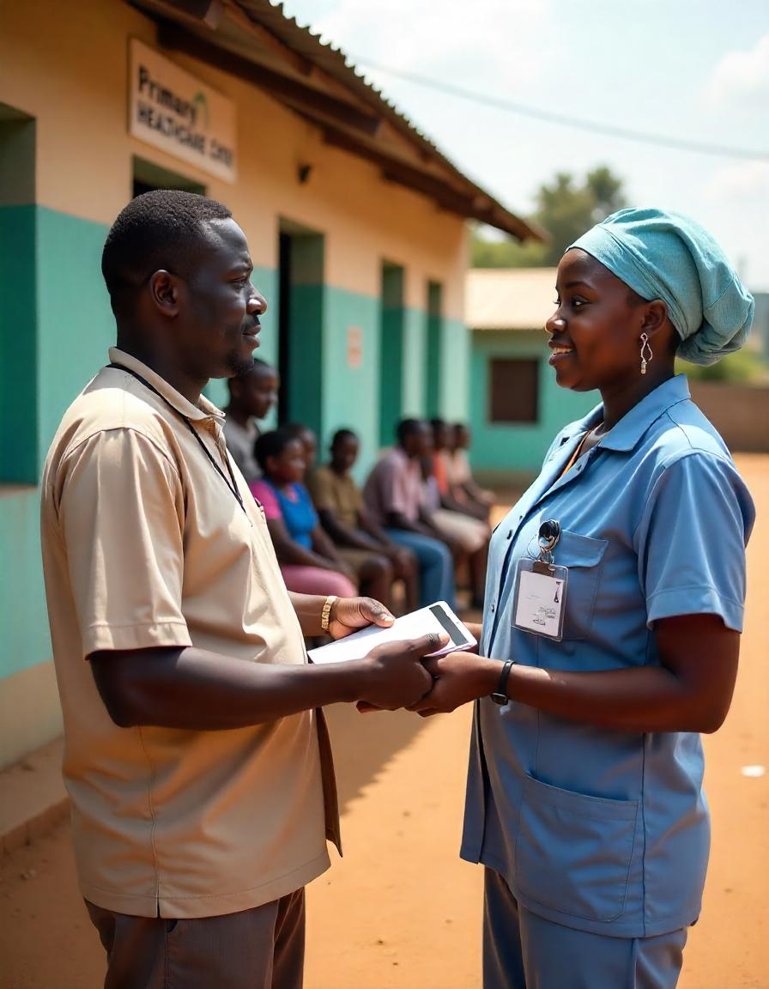
MODULE 2:
PFMOs Roles and Responsibilities

Slide 60
TABLE OF CONTENT
1
5
Introduction & Learning Objectives
Strengthening Health Systems and Infrastructure
2
6
Overview of the work scope, Key deliverable operations of PFMOs
PFMO Management Structure & Key Stakeholders
3
7
Role of PFMOs in Achieving Primary Health Care Goals
Participating in Update Meetings
4
8
Monitoring, and Tracking of PHC Service Utilization
Conclusion
Module 2 - PFMOs Roles and Responsibilities

Slide 61

INTRODUCTION
Primary Health Care (PHC) is the foundation of Nigeria's healthcare system, providing essential services to communities across the country. Ensuring that PHCs operate efficiently, use funds appropriately, and deliver quality care is crucial for improving health outcomes and achieving Universal Health Coverage (UHC).
KEY FOCUS AREAS:
  Roles and responsibilities of performance and financial management officers (PFMOs), who play a key role in monitoring, verifying, and reporting on PHCs.

Slide 62
LEARNING OBJECTIVES
BY THE END OF THIS TRAINING, PARTICIPANTS SHOULD BE ABLE TO:
  Clearly define the roles and responsibilities of the PFMOs
  Support PHC staff to enhance facility management
  Collaborate with key stakeholders to ensure the seamless execution of their responsibilities

Slide 63

OVERVIEW OF THE WORK SCOPE, KEY DELIVERABLES, AND MILESTONES OF PFMOS
The work scope of Performance and Financial Management Officers (PFMOs) is designed to enhance the operational efficiency, financial integrity, and service delivery quality of Primary Healthcare Centers (PHCs). PFMOs are embedded within the healthcare framework as custodians of transparency and accountability, ensuring that every financial and operational process aligns with the objectives of the Basic Health Care Provision Fund (BHCPF)

Slide 64





WORK SCOPE
The day-to-day activities of PFMOs revolve around monitoring, reporting, and supporting PHCs to meet their operational goals. Their objectives include:
Data Collection
Financial Oversight
Operational Monitoring
Generate data for reporting and decision making by effectively tracking PHC facility finances, operations, and investments.
Strengthen BHCPF implementation at PHC facilities nationwide, ensuring transparency, accountability, and value for money.
Improve the performance and quality of services delivered by PHC facilities.

Slide 65

KEY DELIVERABLES
PFMOs are expected to generate comprehensive reports that reflect their assessments and insights. These include:
1
2
Regularly visit PHC facilities (at least twice a month) to assess performance, service delivery, and operational readiness.
Utilize the provided data collection tools (e.g., tablets) to gather and transmit accurate information on financial transactions, service delivery, and facility performance to a centralized database.
3
4
Offer orientation and refresher sessions to PHC staff regarding current financial management practices and tools.
Conduct quality checks, identify gaps, and recommend improvements to enhance service delivery and financial management, ensuring continuous progress in facility performance

Slide 66



PFMOs VISIT GUIDELINES
PFMOs are limited to 2 PHC visits per day (4 hours per visit, excluding travel time) to maintain data accuracy and avoid fatigue.
The visit checklist should be split into the first and second visits to differentiate between initial assessments and follow-ups, ensuring a structured approach to reporting.

Slide 67





DAY-TO-DAY OPERATIONS OF PFMOs
Before visiting a PHC, PFMOs will
During the on-site visits, PFMOs will
At the end of field visits, PFMOs will
  Observe care, engage staff, and assess facility readiness.
  Collect data from the PHC.
  Highlight issues or challenges with financial processes or reporting
  Meet with local government health to discuss resource needs and interface with the LGHA as required
  Review the financial and operational reports from their most recent visit.
  Pinpoint discrepancies or inefficiencies that need immediate attention, check for any instruction from State Supervisor.
  Compile reports on findings to inform feedback and national recommendations.
  Share feedback with PHCs in same visits and recommendations from higher up in next visit.
  Escalate urgent issues identified to approved channels.

Slide 68







ROLE OF PFMOs IN ACHIEVING PRIMARY HEALTH CARE GOALS
1
Strengthen Healthcare
3
Financial Oversight
5
Operational Support
PFMOs are vital to achieving Universal Health Coverage (UHC) and improving healthcare outcomes, bridging gaps between resources, implementation, and results.
PFMOs are to verify that BHCPF funds are properly utilized for the intended use, such as ensuring maternal health funds support antenatal supplies, training, or infrastructure.
PFMOs are to identify facility gaps—staff shortages, equipment needs, or medicine stock-outs—and document them for resolution.
2
Enhancing PHC Capacity
4
Performance Tracking
6
Building Public Trust
PFMOs are expected to significantly strengthens PHCs in their assigned LGA, ensuring equitable healthcare delivery through better safeguard and utilization of PHC finance.
PFMOs will also monitor PHC performance through KPIs like immunization rates and facility attendance to assess expenditure impact.
By monitoring and assessing PHC functionality, PFMOs promote accountability, transparency, and increased public confidence in healthcare services.

Slide 69



PROVIDING SUPPORT FOR HEALTH PROGRAM IMPLEMENTATION
1/2
Best Practice
Monitor PHCs in implementing national health programs like immunization, maternal and child health (MCH), and disease prevention (e.g., malaria control).
Action Steps (1)
Documentation
Immediately and thoroughly document the observed shortage of cold chain storage units and the reported delays in immunization services.
Real-Life Example
During a routine visit to a PHC, you observe delays in administering routine immunizations to children. Upon discussing this with the PHC staff, you realize that there is a shortage of cold chain storage units for vaccines
Action Steps (2)
Reporting
Promptly escalate the documented findings to the State Lead and NPHCDA.
Use financial example, e.g delay in funding and escalation

Slide 70


PROVIDING SUPPORT FOR HEALTH PROGRAM IMPLEMENTATION
2/2
Action Steps (3)
Monitoring
Monitor the situation during routine visits.
Track interim measures taken by the PHC to mitigate the shortage.
Follow up with the State Lead and NPHCDA on the equipment request.
Programmatic Support
PFMOs is to identify and report systemic gaps but do not directly provide vaccine management training. Their role ensures critical issues are addressed by the appropriate authorities.
Improve based on new example

Slide 71
MONITORING AND TROUBLESHOOTING SERVICE DELIVERY GAPS
Action Steps
Best Practice
  Work with PHC management to identify the root causes of absenteeism. If it’s due to a lack of motivation, recommend that the LGA team receive a training session on professional ethics and patient care.
  Collaborate with the PHC to create a more practical shift scheduling system that ensures adequate staffing during peak hours.
  Recommend incentives for health workers (e.g., on-time salary payments, recognition programs) to improve staff morale.
Proactively monitor PHC service delivery and note operational challenges such as inadequate staffing, equipment malfunctions, or supply chain disruptions.
these are detailed programme action steps, not for PFMOs
Real-Life Example
While visiting a PHC, you notice a backlog of patients waiting for basic health services due to understaffing.
After discussing with the officer-in, you learn that the PHC is struggling with absenteeism.
Programmatic Support
Your support helps the PHC enhance its service delivery, ensuring that patients are attended to promptly and that quality care is consistently provided, improving health outcomes.
Need new case examples

Slide 72
STRENGTHENING HEALTH SYSTEMS AND INFRASTRUCTURE
Action Steps
Best Practice
  Conduct a quick troubleshooting session with the PHC’s technical staff to determine if a simple fix (e.g., replacing a fuse, or refueling) is possible.
  If the issue cannot be resolved on-site, assist the PHC in submitting a formal request for repair or replacement to the State Lead or NPHCDA.
  Escalate to LGA on need for maintenance schedule and provide feedback to the PHC.
Monitor the maintenance of essential health infrastructure and systems to ensure PHCs are operational and able to deliver services effectively.
Real-Life Example
Programmatic Support
During an inspection, you find that the PHC’s generator is malfunctioning, and they are experiencing frequent power outages, which is hindering service delivery, especially in the evening shifts.
By ensuring the availability of reliable power, you help the PHC maintain its ability to provide uninterrupted health services, including emergencies, overnight care, and essential laboratory services.

Slide 73

PFMO MANAGEMENT STRUCTURE AND KEY STAKEHOLDERS
PFMO Management structure
NPHCDA
BHCPF Lead
Innovius HQ
Nigeria's Primary Health Care (PHC) system operates as a decentralized structure, designed to deliver comprehensive, accessible, and equitable health services. PFMOs must navigate this ecosystem effectively to ensure the seamless execution of their responsibilities.
SMOH
BHCPF
Zonal director
Zonal Liaison
SPHCDA ES
BHCPF FP
NPHCDA SC
Liaison
SPHCB
Innovius State Supervisor
LGAC
LGA
LGHA
Oversight
Oversight
PHC
PFMOs
Bi monthly monitoring
Liaison
Innovius Interacts at the State level with NPHCDA SC, NPHCDA Zonal Coordinator, SPHCB; at the National - Innovius HQ to NPHCDA HQ
WDC
Feedback
Reporting
Fig. 1 PFMO Management Structure

Slide 74
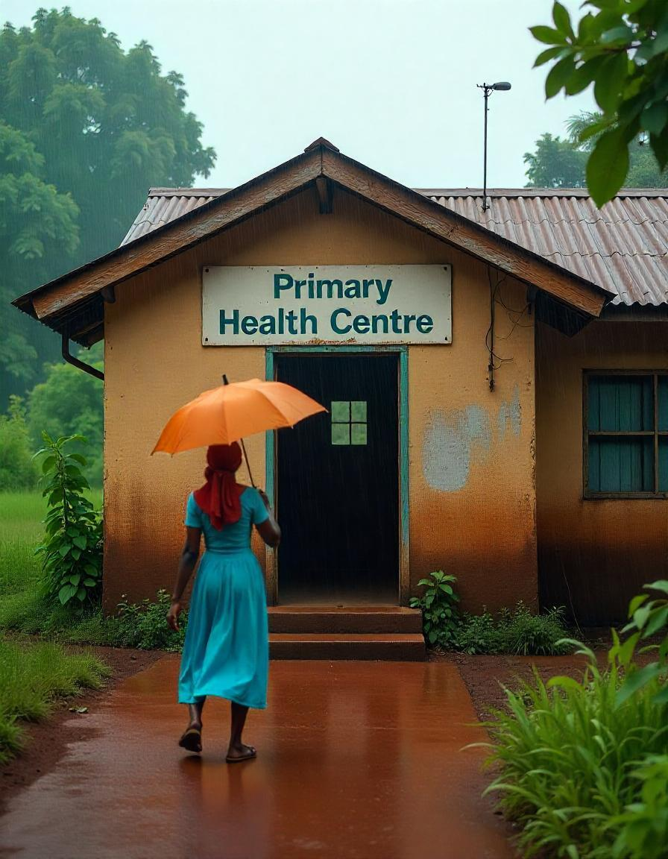
PFMO MANAGEMENT STRUCTURE AND KEY STAKEHOLDERS
1/2
  PHC facilities vary from small health posts to comprehensive centers, offering preventive, promotive, and curative services.
  Key stakeholders include health workers, community leaders, development partners, and policymakers, with PFMOs ensuring collaboration for improved service delivery.
  PHCs focus on patient-centered care, including maternal and child health, immunization, disease prevention, and emergency care, with PFMOs assessing service effectiveness and alignment with national health priorities.
Use TOR

Slide 75

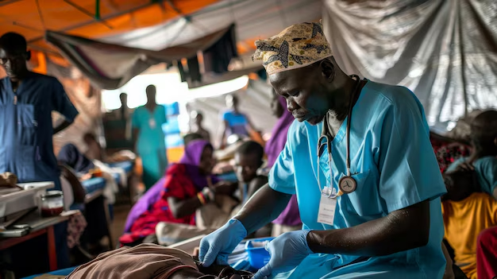
REPORTING LINES AND RESPONSIBILITIES
Feedback & Reporting Flow
Who Do You Report To?
PFMOs → State Leads
STATE LEADS
  As a PFMO, your primary reporting line is to the State Leads
  You provide updates and submit briefs about your monitoring activities to LGHA
  You also receive guidance and feedback from them
Reporting: Submit Reports
Feedback:
Receive Guidance
PFMOs

Slide 76












YOUR ROLE IN THE LARGER STRUCTURE
Work with PHCs
LGHA/SPHCDA
NPHCDA
Your reports contribute to oversight by Local Government Health Authorities (LGHA) and State Primary Health Care Development Agencies (SPHCDA)
The National Primary Health Care Development Agency (NPHCDA) oversees national operations
You work closely with Primary Health Centers (PHCs) to monitor PHC facility performance and fiduciary processes.

Slide 77

PFMO Responsibilities
PARTICIPATING IN UPDATE MEETINGS
Preparation
  Compile and analyze performance data for PHCs within their assigned area, focusing on key indicators
  Identify factors contributing to performance gaps and suggest potential interventions.
Participation
  Participate in discussions regarding performance trends, contributing insights and explanations.
  Collaboration with other States Leads to the development of strategies for performance improvement.
  Offer constructive feedback on performance monitoring processes and tools.
Follow-up
  Communicate performance feedback and agreed-upon actions to PHC staff
  Monitor the implementation of performance improvement plans
  Track progress towards targets and report on outcomes.
01
PFMOs play a vital role in communication, coordination, and decision-making within the healthcare system.
02
Key Meeting: Performance Review Meeting
Frequency: Monthly
Participants: SPHCB, NPHCDA SC, Innovius state leads and PFMOs
Purpose: Evaluate and analyze PHC performance.
Role of PFMOs: Share insights, monitor progress, and contribute to improvement strategies.
03

Slide 78

a
Professionalism
  Arrive on time and be prepared
  Dress appropriately
  Maintain respectful and professional communication
b
Active Listening
GENERAL MEETING GUIDELINES
  Pay close attention to presentations and discussions
  Take notes and ask clarifying questions.
c
Constructive Participation
  Share relevant information and insights
  Offer constructive feedback and suggestions
  Respect diverse perspectives
d
Follow-up and Accountability
  Document key decisions and action items
  Follow through on assigned tasks
  Communicate relevant information to relevant stakeholders

Slide 79
PFMOs are essential to the success of Nigeria's healthcare system. Their role goes beyond monitoring finances—they identify and report on service delivery gaps at the PHCs, to promote accountability and transparency.
CONCLUSION

Slide 81
MODULE 3:
Financial Management

Slide 82
TABLE OF CONTENT
1
3
Fund Utilization and Accountability Across PHCs
Introduction
Why is Financial Management Important in PHCs?
What is PHC Funding supposed to be Used For?
Ensuring Money is Used for approved Purposes
What PFMOs Must Do in Practice
Why is It Important to Use PHC funding Correctly?
2
PHC Funding
4
Identifying and Reporting Financial Irregularities
Where Does PHC Funding Come From?
Federal Government Funding (Tier 1)
State Government Funding (Tier 2)
Local Government Funding (Tier 3)
Local Government Funding (Tier 3)
Other sources of funds
Understanding Financial Irregularities in PHCs
How to Identify Financial Red Flags
Reporting Financial Irregularities
Role of PFMOs in Financial Oversight
5
Conclusion
Module 3 - Financial Management

Slide 83

INTRODUCTION
KEY FOCUS AREA:
  Provide an understanding of financial management in PHCs, including its components, sources of funding, responsibilities of performance and financial management officers (PFMOs), and how to identify and report financial irregularities.
Financial management in Primary Health Care (PHC) centers is critical to ensuring that funds are properly handled, allocated, and accounted for.
Goals: Prevent misuse, optimize spending, and improve service delivery.

Slide 84


WHY IS FINANCIAL MANAGEMENT IMPORTANT IN PHCS?
Proper financial management in PHCs ensures that funds are used correctly to ensure health services are available in the community. It has the following importance :
Ensures Continuous Health Services
Prevents Misuse and Loss of Money
Helps in Planning and Budgeting
When money is properly managed, PHCs can afford medicines, medical supplies, and staff salaries without unnecessary delays.
By keeping proper records and following financial rules, PHCs avoid fraud, overspending, and other financial problems
Knowing how much money is available and what it is meant for helps PHCs plan their expenses, such as buying equipment and maintaining the facility.
Builds Trust and Transparency
Improves Decision-Making
Ensures Compliance with Government Rules
When PHCs manage money properly, the government, donors, and the community have confidence that funds are being used for healthcare services.
Good financial records help PHC managers and decision-makers know where funds are needed most and how to improve services.
The government has financial guidelines that PHCs must follow. Proper financial management helps PHCs stay within the law and avoid penalties.

Slide 85
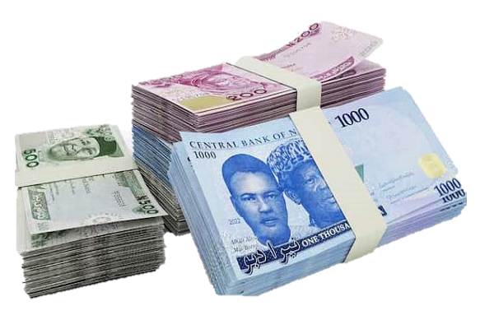


PHC FUNDING
  Primary Health Care (PHC) centers in Nigeria are the foundation of the country’s healthcare system, providing essential medical services to millions.
  Funding is crucial for PHCs to deliver health services, but challenges have historically limited their effectiveness.
  To address these challenges, the Nigerian government established the Basic Health Care Provision Fund (BHCPF) as a dedicated financing mechanism.
  The BHCPF aims to strengthen PHCs, improve healthcare access, and reduce financial barriers, especially for vulnerable populations.

Slide 86


WHERE DOES PHC FUNDING COME FROM?
1/4
In Nigeria, PHC funding comes from different levels and sources. Each level has a role in ensuring that health centers have money to operate properly.
Federal Government Funding (Tier 1)
The Federal Government provides money for PHCs mainly through the Basic Health Care Provision Fund (BHCPF). This fund is taken from the national budget and is shared in two ways
01.
48.5% goes to the National Health Insurance Scheme (NHIA):
This helps provide basic health services for Nigerians
The National Primary Health Care Development Agency (NPHCDA) also helps by giving training, technical support, and guidance to PHCs
02.
50% goes to PHC services:
This is used to buy medicines, vaccines, and equipment, train health workers, and improve PHC facilities

Slide 87


FUNDING OF BHCPF
NCDC
Gateway
(1.25%)
At least
Donors &
Other
BHCPF
1% CRF
Partners
sources
NHIA
Gateway (48.75%)
NPHCDA
Gateway Fund (45%)
EMT
Gateway (5%)
6

Slide 88




The BHCPF is backed by NHAct 2014 and disbursed through Four Gateways
Funding sources:
Grants from donors and partners
1% FGN Consolidated Revenue Fund
Funds from any other source
Gateways
Proportion
Details
National Health Insurance A (NHIA)
48.75%
These funds will be used to provide a basic minimum package of health services(BMPHS) in PHC facilities through NHIA
National Primary Health Care Development Agency (NPHCDA)
45%
20%
Provision of Essential medicine, vaccines and consumables in PHCs
15%
Provision and maintenance of facilities, equipment and transportation in PHCs
10%
For Development of Human Resource for Primary Healthcare
National Emergency Medical Treatment Committee(NEMTC)
5%
This will be used to respond to medical emergencies through the establishment of an emergency ambulance service in Nigeria
Nigeria Centre for Disease Control (NCDC)
1.25%
This will be used to respond to public health emergency, disease outbreak response and surveillance
Notes:
This is latest slide that speaks abt all the four gateways

Slide 89
Fund Disbursement
As part of efforts to improve efficiency of the processes at all levels (such as timely Quarterly authorization and disbursement, retirements etc) under the new reforms, Stricter measures have been put in place which will served as basis for performance recognition and will be sanctions appropriately.
Upon receipt of the 45% component of the BHCPF from the federation account, the NPHCDA shall within Ten (10) working days disburse funds to all qualifying SPHCAs TSA account which have successfully retired previous quarters funds and cleared by the NPHCDA Task force team,
The SPHCDAs shall in turn disburse electronically directly to benefitting and eligible PHC facilities PHCs who had successfully retired previous quarter no later than ten (10) working days from date of receipt.
Disbursement to State and PHCs shall now be on a quarterly basis which will be backed with an authorization from NPHCDA and list of eligible PHCs, their DFF tiers and if they are entitled to performance-based incentive payments)
Eligibility criteria for Authorization and Quarterly disbursement:
  Timely submission of complete quarterly retirements,
  Timely submission of due quarterly Programme and financial reports inclusive of quality Assessment.

Slide 90







The NPHCDA Gateway Fund flow through the SPHCB/A to eligible PHCs as DFF, performance incentives and for HRH interventions at state level
NPHCDA Gateway 45% of BHCPF
20% of the NPHCDA operational fund for MOC operation
10% for NPHCDA Gateway Operations and accountability tracking
SPHCB/A (TSA)
15% of the SPHCDA operational fund for SOC operation
15% of for SPHCDA & LGHA Operations
Part of the DFF at state level will be reserved for payment of performance incentives to PHCs
PHC HRH
Transfer are conditional and implementation arrangements to be cleared, tracked and supervised by the NPHCDA.
DFF to PHC
(PHC Facility Account)
Essential medicines and consumables, Utility and maintennance, fueling, transport, waste management, meeting support, finance, ad-hoc HR, stationeries.
SOURCE: Team analysis, BHCPF guideline

Slide 91
WHERE DOES PHC FUNDING COME FROM?
2/4
State Government Funding (Tier 2)
The State Government oversees the management of PHC services in each state and allocates funds for:
01.
Building and repairing PHC
facilities
03.
Training health workers
02.
Buying essential medicines and medical supplies.
04.
Running community health programs.
This money is disbursed through the State Primary Health Care Development Agency (SPHCDA) to ensure PHCs function adequately.

Slide 92
WHERE DOES PHC FUNDING COME FROM?
3/4
Local Government Funding (Tier 3)
The State Government oversees the management of PHC services in each state and allocates funds for:
01.
Running PHCs and providing basic health services to the community.
03.
Paying PHC staff salaries.
02.
Maintaining health centers and equipment.
04.
Supporting community health workers and volunteers.
The Local Government often works with Ward Development Committees (WDCs) to decide how to use funds for local health needs. While LGAs by Health Policy are responsible for PHC, PHCOUR enable State Funds an integrated system.

Slide 93
WHERE DOES PHC FUNDING COME FROM?
4/4
Other Source of Funding
01.
Donor and Partner Support
02.
Community Contributions and Insurance Schemes
  International organizations, NGOs, and private donors provide money, medicines, and equipment to support PHCs.
  Some donors give money for specific programs like immunization, maternal health, or disease control.
  These funds must be used according to the agreements with the donors.
  Some PHCs receive money from community health programs or health insurance schemes where patients pay small amounts to get care when needed.
  Other funds may come from services like laboratory tests or consultations.

Slide 94


FUND UTILIZATION AND ACCOUNTABILITY ACROSS PHCs
PFMOs are responsible for tracking and protecting PHC funds to ensure they are used correctly. Their work helps prevent missing money, fraud, or misuse. A PFMO’s financial responsibilities involve the proper utilization of funds.

Slide 95
NPHCDA Gateway Financial Flow cycle
Disbursement by MOC to Gateways
Disbursement by NPHCDA Gateway to SPHCB/A
Approval of SPHCB/A annual workplans
Conditionalities for Quarterly DFF Authorization
Quarterly DFF Authorization
Disbursement to PHCs by SPHCB/A
Successful retirement for due quarters
Submission of quarterly Quality Assessment Result
Submission of quarterly program reports
Submission of quarterly financial statements
Quarterly Retirement by SPHCB/A to NPHCDA
Quarterly Retirement by PHCs via LGHA to SPHCB/A
All submissions are based on standardized formats

Slide 96







WHAT IS PHC FUNDING SUPPOSED TO BE USED FOR?
PHC money is meant to improve healthcare services and must be used correctly. It should only be spent on
Maintaining the PHC Facility
Paying Staff Salaries and Allowances
Administrative and Utility Costs
To ensure doctors, nurses, midwives, and other health workers are available to care for patients.
To repair the health facility buildings, buy equipment, and keep the health center clean and safe.
To pay for electricity, water, and transport to help the PHC run smoothly.
Buying Medicines and Medical Supplies
Providing Health Services
Emergency Health Services
To keep essential drugs, vaccines, syringes, and bandages available for treatment.
To support programs like immunization, maternal care, antenatal care, and disease prevention.
To respond to urgent medical needs like outbreaks or accidents.

Slide 97
WHAT IS PHC FUNDING SUPPOSED TO BE USED FOR?
Category of eligible item
Description
1. Essential medicines and commodities
Purchase of seed drugs, Laboratory reagents, equipment, treatment commodities (cotton wool, gauze, IV given sets and bandages) etc.
2. Consumables
Purchase of detergents, disinfectants, and bleach etc.
3. Ad-hoc Human Resources
Payment for hire of temporary staff i.e., midwife, cost of in-house facility-based training, support for staff performance and recognition etc
4. Transportation
Transport for out reaches and emergency referrals, transport for vaccine collection and returns of vials
5. Utility and maintenance
Electricity, water, borehole & generator maintenance, airtime, internet services, Sign post minor facility maintenance and repairs etc.
6. Waste management
Purchase of waste bins and other gadgets, payment to waste management agent, maintenance of incinerator, movement of waste etc.
7. Fuelling
Fuel for generator, motorcycle, and lamps, cooking gas, etc.
8. Stationeries
Registers, writing materials, Envelope, Letter headed papers, Papers, consultation cards and folders etc
9. Meeting Support
Management meeting, transport for WDC meeting, transport for community dialogue discussion etc
10. Bank charges
Bank statement, cheque book, transfer charges, maintenance charges etc.
Financial expenditures outside the 10 eligible items is in violation of the BHCPF guideline

Slide 98
Fund retirement
The main aim of this process is to provide objective and verifiable proof that disbursed funds were used as planned at the health facility
Health facilities must properly document fund utilization using provided templates and submit to LGHA
LGHA compiles retirements for all health facilities and SPHCBs collates the retirements from all LGAs
PHCs would be expected to keep original receipts for all purchases and expenditure in a safe cupboard within the facility for at least 7 years (inline of extant laws) for the benefit of auditing

Slide 99




A flow chart and timeline of quarterly retirement process across all levels
Month and Week of the year
Retirement level
Responsibility
1st Quarter
2nd Quarter
3rd Quarter
4th Quarter
PHC facility fills quarterly financial reporting template at the end of the quarter and share with LGHA
Officer-in-charge PHC
April 1st week
July 1st week
Oct 1st week
Jan 1st week
LGHA collates and reviews financial reports and feeds into the LGA retirement summary template and transmit copies to SPHCDB&SSHIA
LGHA officer
April 2nd week
July 2nd week
Oct 2nd week
Jan 2nd week
The SPHCB/SSHIA reviews and collates retirements from all LGAs into the state retirement summary template
A report is generated and shared with the NPHCDA/NHIA
DFA, SPHCB/SSHIA
April 3rd week
July 3rd week
Oct 3rd week
Jan 3rd week
CEO SPHCB/SSHIA
May 1st week
August 1st week
Nov 1st week
Feb 1st week
For NPHCDA Gateway, Accountants collates, and reviews retirements submitted by the 36 states and FCT
NPHCDA Retirement Taskforce
May last week
Aug last week
Nov last week
Feb last week
NPHCDA authorized further disbursements based on States with cleared retirements
NPHCDA
June 1st week
Sept 1st week
Dec 1st week
April 1st week

Slide 100

Retirement
Under the new reforms the following three criteria must be met during the quarterly retirement process:
Timeliness:
Retirement must be submitted on time in line with the published schedule and timeline.
One quarter Lag is still maintained to allow seamless implementation and prevent service disruption
01
Completeness:
Programmatic and financial reports,
Receipts from state level operations,
Completed Quarterly financial summary forms(LGA and State) reports, in accordance with the shared templates with the states.
Bank statements for all PHCs reflecting the quarter (corresponding 3 months)
02
Validation:
Based on timeliness and completeness of submissions, states will be initially cleared and authorized for disbursement pending validation of the retirement submissions
Retirement documents will be validated through continuous audit’ by the OAGF in collaboration with NPHCDA
03
Non-adherence to retirement deadlines will be sanctioned appropriately

Slide 101
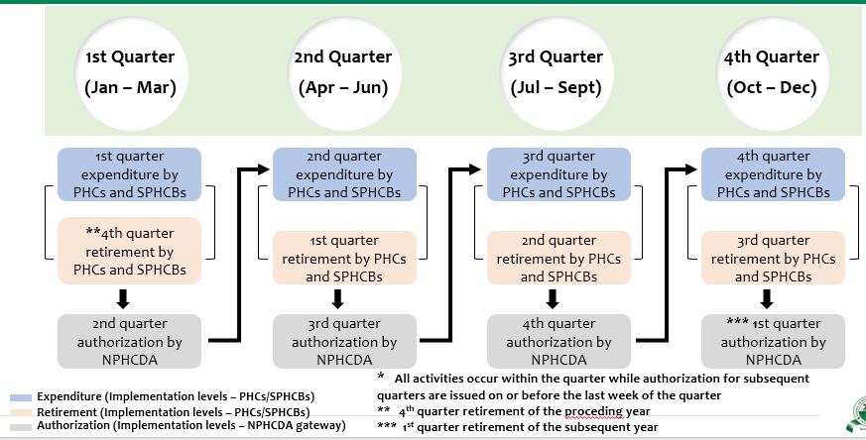
Quarterly Process flow for Fund Disbursement, Expenditure and Retirement

Slide 102
Improved accountability tracking mechanism have also been identified, to ensure more value for money and enable BHCPF realise its full potentials
SN | Tracking Mechanism
1 | Continuous auditing from both internal and external bodies like Office of the Auditor General of the Federation
2 | Digitalization of financial processes that will enable end to end tracking (across PHC, LGHA, SPHCB and National) and visibility of disbursement and expenditure
3 | Engagement of PFMOs to be deployed to 774 LGAs across the country
4 | Community involvement, Ward Development Committees
5 | Civil Society Organizations (CSOs)
6 | Collaboration with ICPC on fund tracking
7 | Media
PFMO: Performance and Financial Management Officers,

Slide 103
Fiduciary Controls and Sanctions
All major infractions ( such as non-disbursement of funds to PHC resulting from misuse and/or embezzlements at any level will lead to suspension of State which will be reported by the NPHCDA to the Executive Governor.
Financial infractions that are not embezzlement involving breach in guidelines or public financial rules at LGA and facility level are to be dealt with by the SPHCB and SMOH in line with the state civil service rules and financial regulation and report same to the SOC and the NPHCDA.
Suspended states may only be re-admitted into the Gateway following full remediation including refund of all the BHCPF funds deemed to be misused to the main Gateway BHCPF TSA not state TSA.
Major incidents involving financial loss or embezzlement may be referred to relevant agencies (such as ICPC) post audit evidence.
    Penalties for Late OR Non-submission of Quarterly Retirement Documentation:
In the event a state submits late or incomplete retirement documentation beyond the stipulated quarterly deadline the following sanctions shall apply:
  Late submission by state of retirement reports (inclusive as required programme reports and conduct of remediation activities if applicable), but within the ‘grace period’ the state shall forfeit 10% of its total funds for the quarter to the central Gateway pool.
  Should the state further miss the final deadline stipulated, there would be no authorization for disbursement to the state for that quarter and the funds shall be forfeited to the central pool of the NPHCDA Gateway TSA Account.

Slide 104

ENSURING MONEY IS USED FOR APPROVED PURPOSES
1/2
Understand the PHC Budget and Allowed Expenses
  PFMOs must review the PHC budget to know which expenses are approved and how much can be spent. This helps ensure funds are used correctly.
  Example: If ₦20,000 is allocated for stationery, any spending beyond this amount should be noted and reported.
Monitor and Flag Overspending
  All expenses should be checked against the budget to make sure they do not exceed the approved limits. If spending goes over the budgeted amount, the issue must be reported to the State Leads.
  Example: If ₦100,000 is budgeted for medicine but ₦150,000 is spent, the PFMO must flag and report this difference.
Verify Spending Without Questioning PHC Staff Directly
  PFMOs compare financial records with actual supplies and services to ensure accurate spending. Any differences are documented and reported to the NPHCDA.
  Example: If a facility reports buying medical supplies but stock records show less than what was purchased, the PFMO records the issue for review.

Slide 105
ENSURING MONEY IS USED FOR APPROVED PURPOSES
2/2
Monitor Purchases and Deliveries
  PFMOs must confirm that all items paid for are delivered and being used at the PHC.
  Example: If ₦50,000 is spent on chairs, the PFMO checks that the chairs arrived and are in use at the facility.
Report Any Unapproved Spending
  If funds are used for unapproved or personal purchases, the PFMO must report it immediately.
  Example: If PHC funds are used to buy a personal laptop for the PHC manager, the PFMO must document and report this misuse.

Slide 106


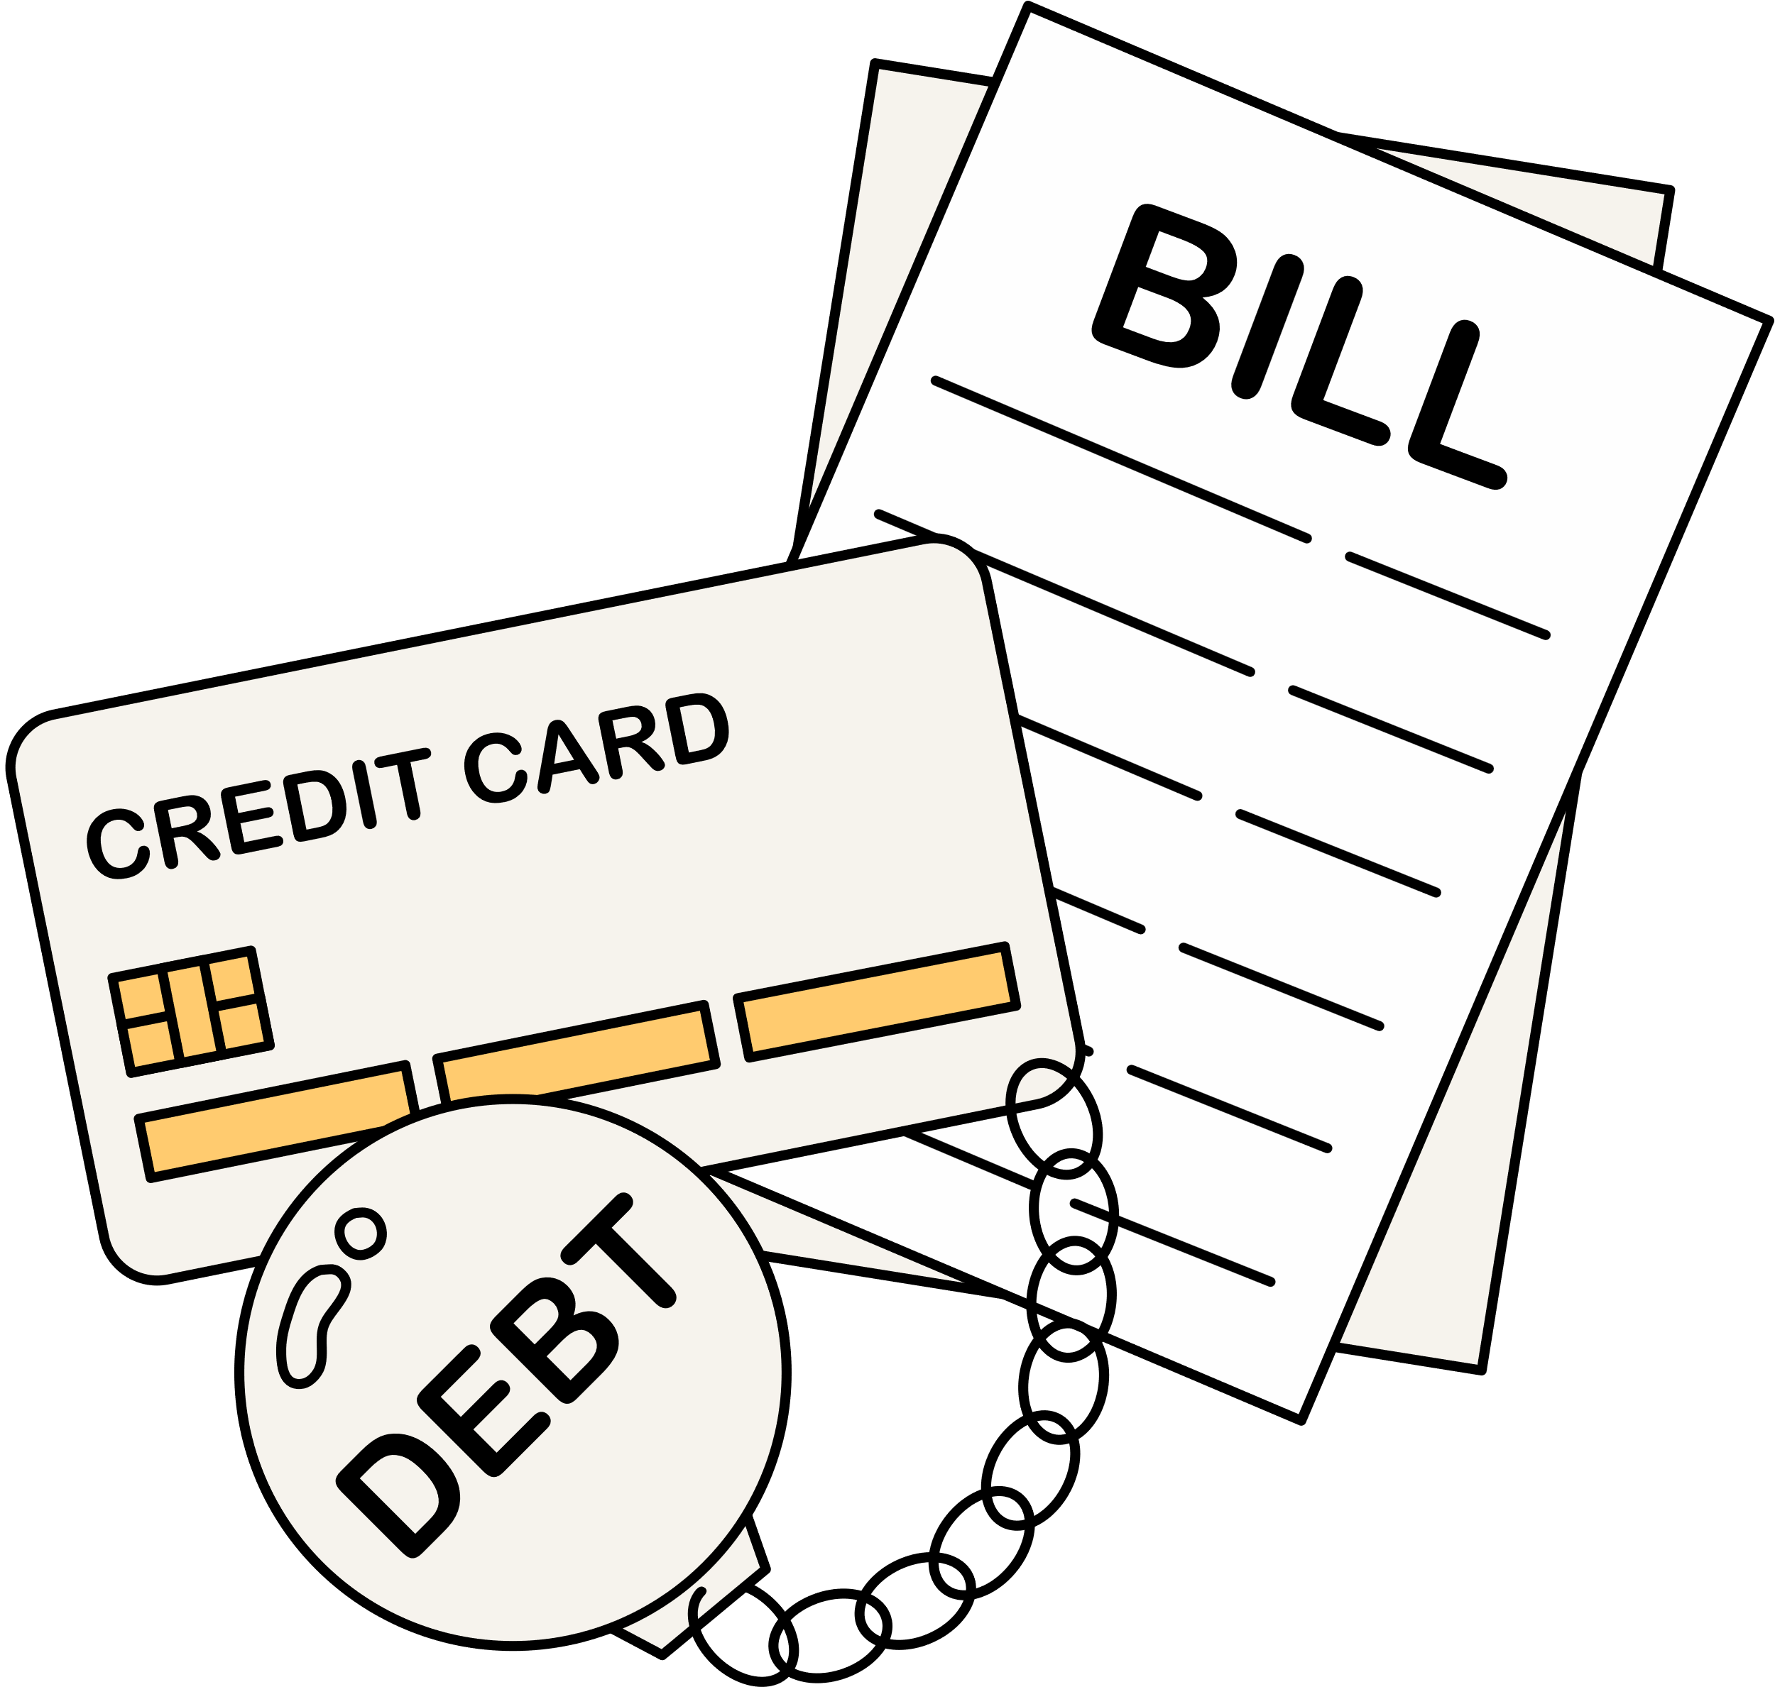



UNDERSTANDING FINANCIAL IRREGULARITIES IN PHCs
Proper financial management is vital for PHCs to deliver quality healthcare. Financial issues may arise from errors, weak systems, or fund misuse, leading to missing records, unauthorized spending, excessive withdrawals, and non-deposited funds—any violation of financial guidelines is an irregularity.
Misused PHC funds harm the community, leading to poor healthcare services, unpaid staff, inadequate supplies, and loss of trust.
Essential medicines and vaccines become unavailable.
PHC staff may not be paid, affecting service delivery.
Communities lose trust in the healthcare system.
Government and donor funding may be reduced.
Individuals involved in fraud may face legal action.

Slide 107
HOW TO IDENTIFY FINANCIAL RED FLAGS 1/2
Red flags take different forms and are warning signs that something might be wrong with PHC finances.
They do not always mean fraud is happening, but they must be checked carefully. Understanding these misconducts helps PFMOs identify, report, and prevent financial losses in PHCs.
Red flags
Description
Missing or Incomplete Financial Records or Refusal to Present Records
Important documents like receipts, invoices, or cash book entries are unavailable or incomplete.
Example: The PHC buys drugs worth ₦500,000, but no receipts are available to confirm the purchase or lack of authorizing signature.
Financial documents to be made available include Receipts and Payment Vouchers, Cash Book, Bank Statements, Ledger, Budget and Expenditure Reports, Procurement Records, and Payroll Records[1] .(Kindly find samples via https://drive.google.com/drive/folders/1lJfIqs8W58uX4m6ppyLpEVpar4ihZMS-:
Unauthorized Spending
Inflated or Fake Invoice
Money is spent on unapproved expenses or outside the PHC budget.
Example: Funds meant for immunization are used to buy office furniture.
Can we show samples of this evidence?
Inflated or Fake Invoices
Suppliers overcharge or submit invoices for items that were never delivered.
Example: An invoice shows ₦80,000 for cleaning supplies, but only ₦50,000 worth was received
Excessive Cash Withdrawals
Large sums of money are withdrawn without proper explanation or supporting documents.
Example: A PHC has a withdrawal limit of ₦200,000 per month, but ₦600,000 is withdrawn with no approval.

Slide 108

Samples of PHC Financial Documents
Annual Quality Improvement Plan Template
1. Cover Page
Slide and notes on book keeping
Voucher etc → slides from Sekina from BHCPF finance training slides

Slide 109
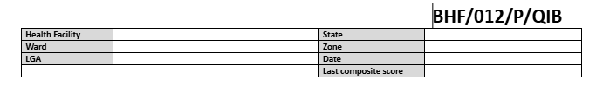
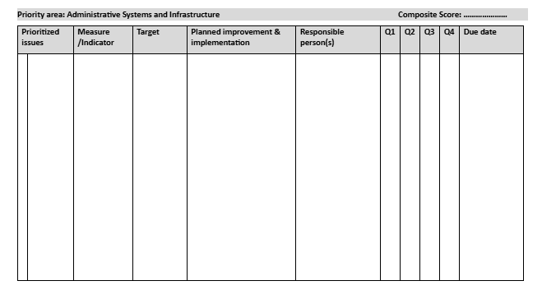
Samples of PHC Financial Documents
Annual Quality Improvement Plan Template
Click here to view the sample document.

Slide 110
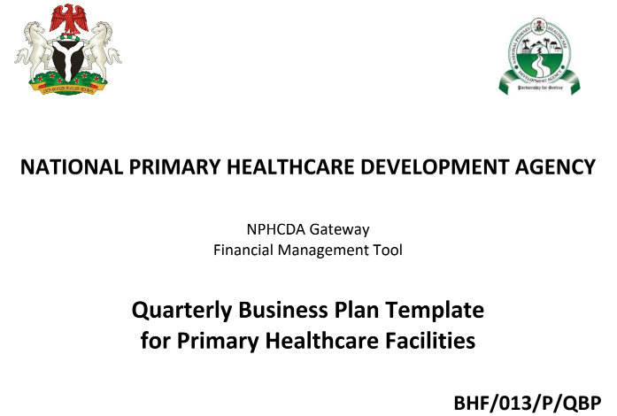
Samples of PHC Financial Documents
Quarterly Business Plan Template
1. Cover Page
Introduction to financial app
PHC —FMS
→ Session for use of tools
how to develop QBP
monthly summary forms
expenditure report

Slide 111
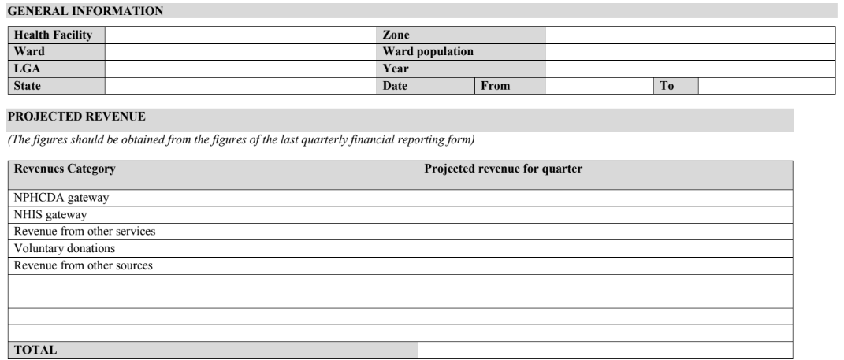
Samples of PHC Financial Documents
Quarterly Business Plan Template
Click here to view the sample document.

Slide 112
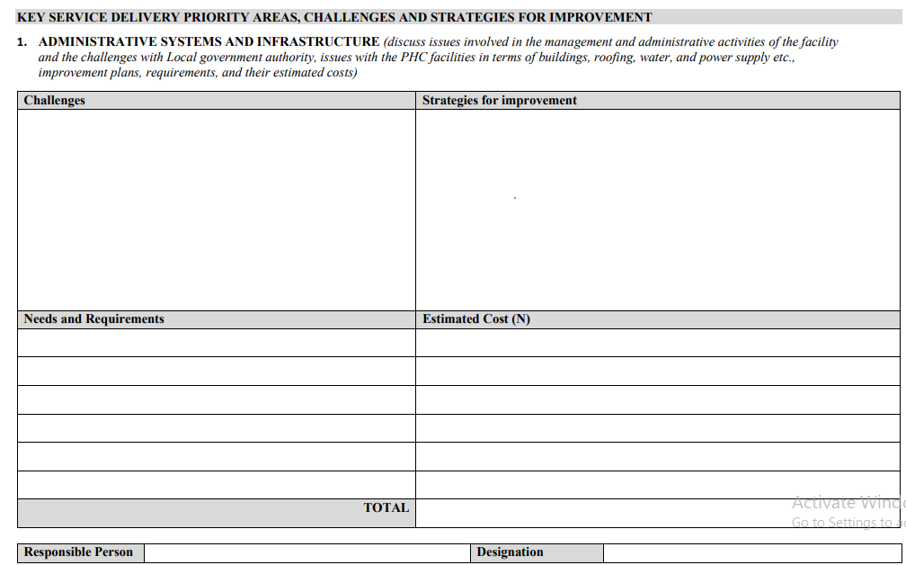
Samples of PHC Financial Documents
Quarterly Business Plan Template

Slide 113
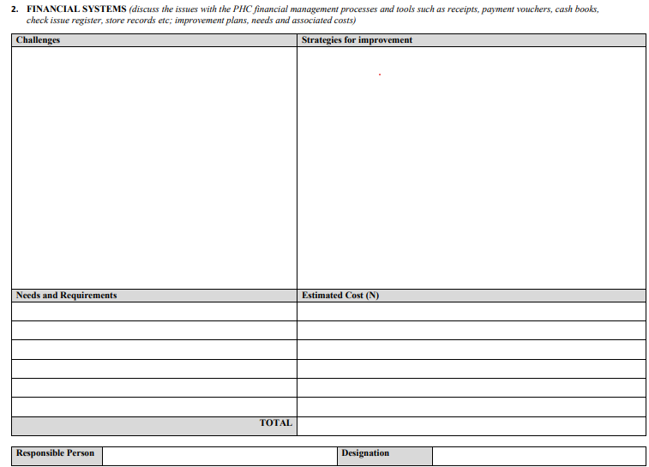
Samples of PHC Financial Documents
Quarterly Business Plan Template

Slide 114
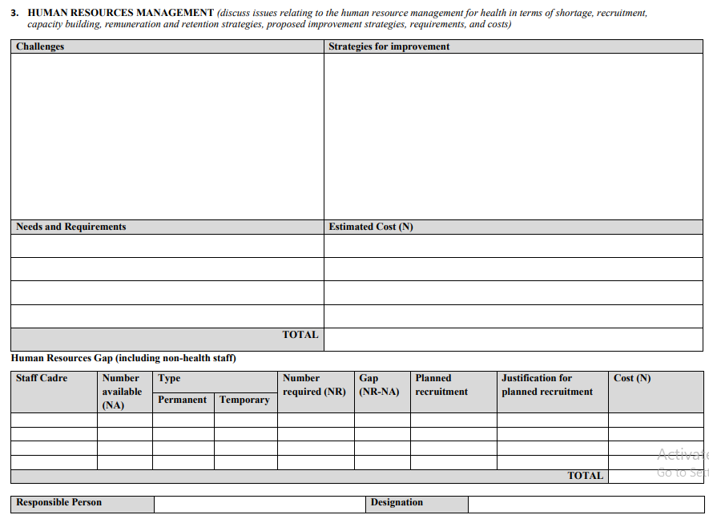
Samples of PHC Financial Documents
Quarterly Business Plan Template

Slide 115
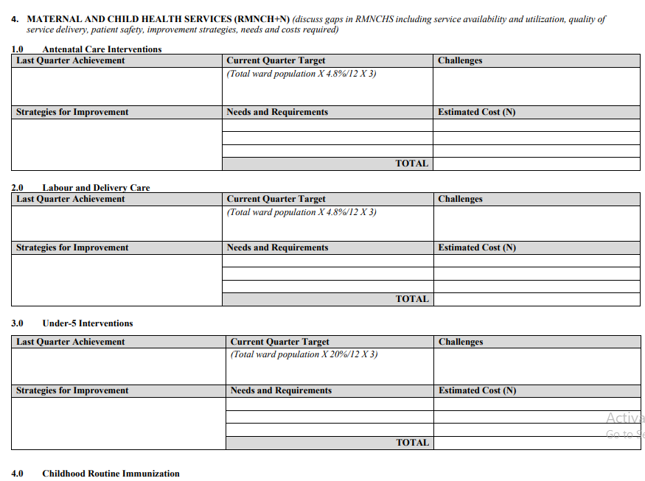
Samples of PHC Financial Documents
Quarterly Business Plan Template

Slide 116
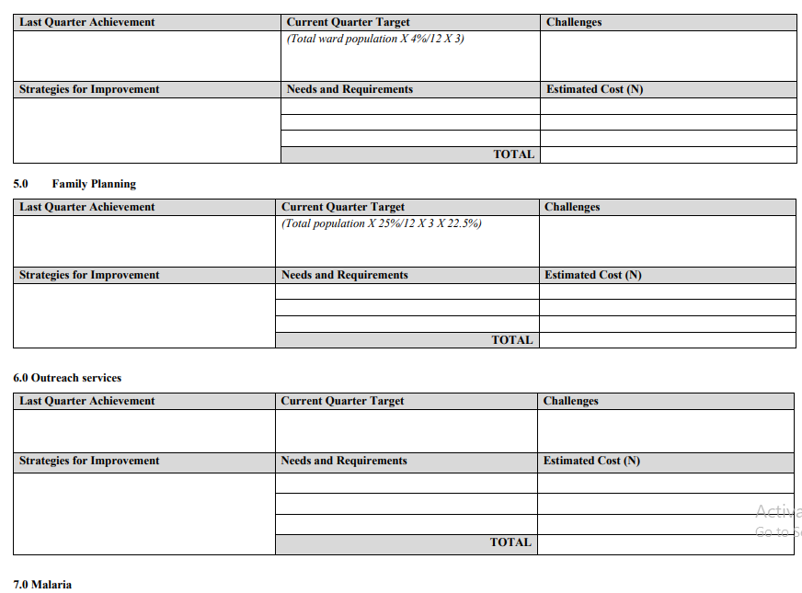
Samples of PHC Financial Documents
Quarterly Business Plan Template

Slide 117
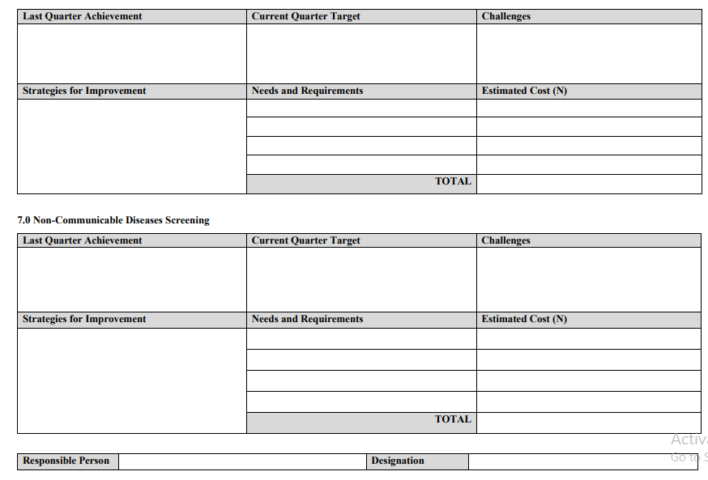
Samples of PHC Financial Documents
Quarterly Business Plan Template

Slide 118
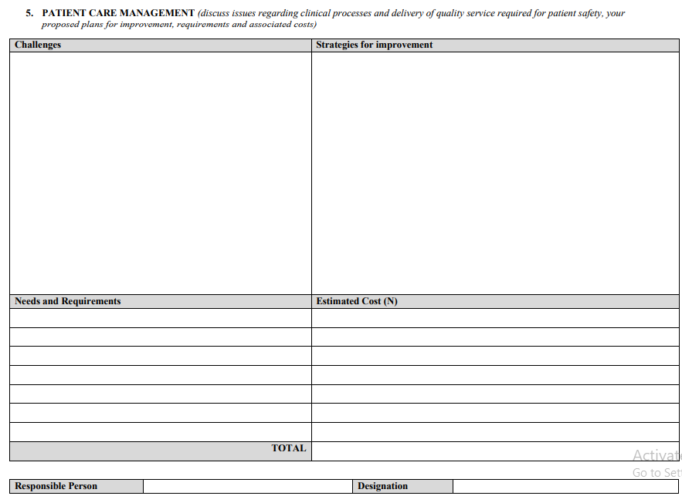
Samples of PHC Financial Documents
Quarterly Business Plan Template

Slide 119
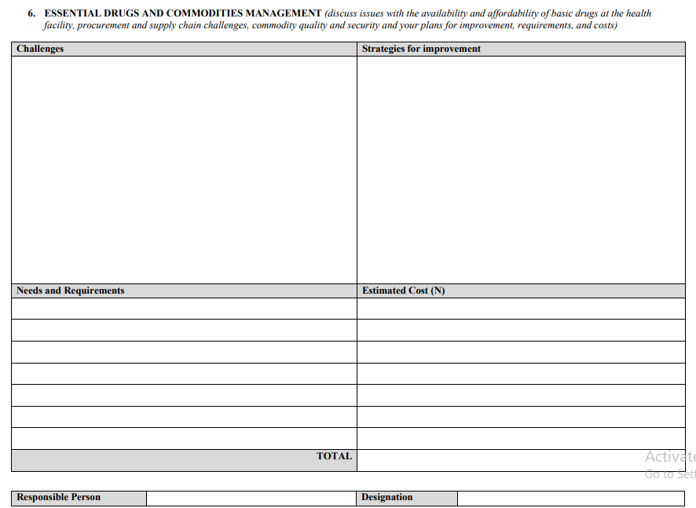
Samples of PHC Financial Documents
Quarterly Business Plan Template

Slide 120
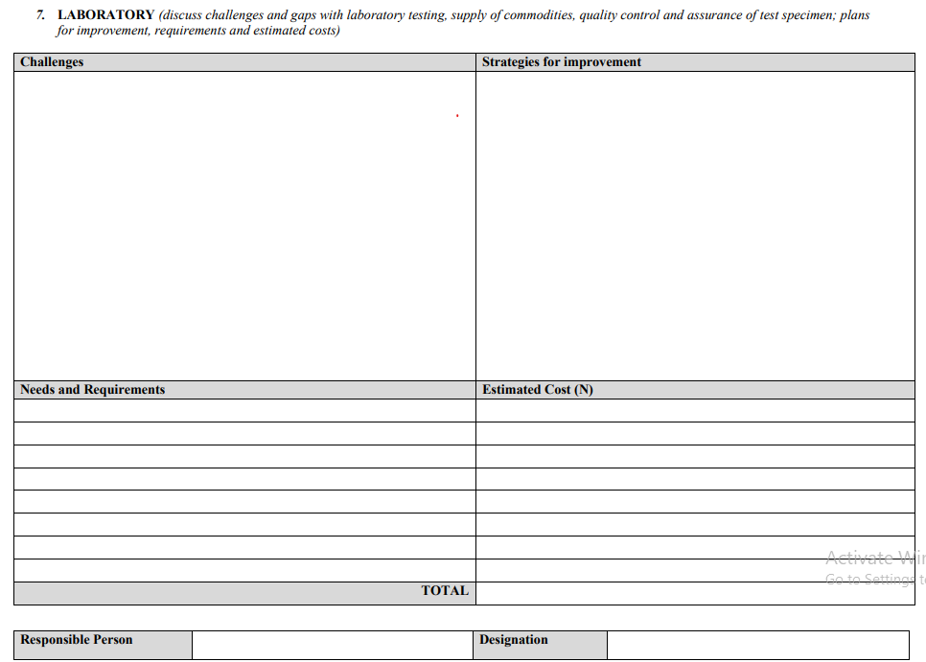
Samples of PHC Financial Documents
Quarterly Business Plan Template

Slide 121
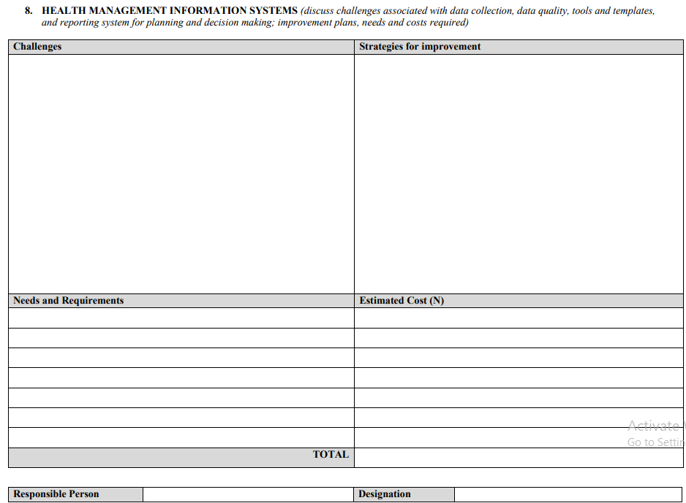
Samples of PHC Financial Documents
Quarterly Business Plan Template

Slide 122
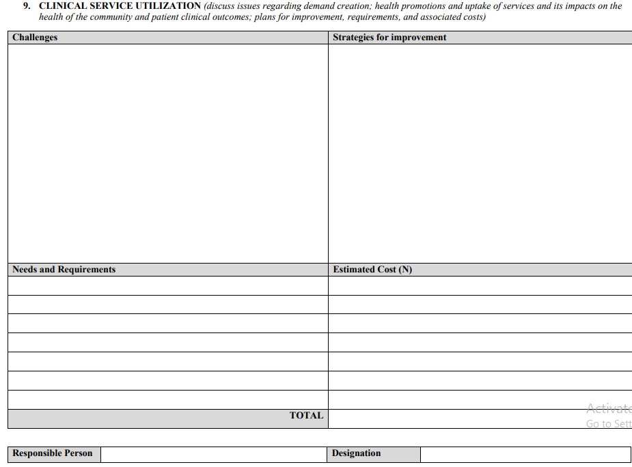
Samples of PHC Financial Documents
Annual Quality Improvement Plan Template

Slide 123
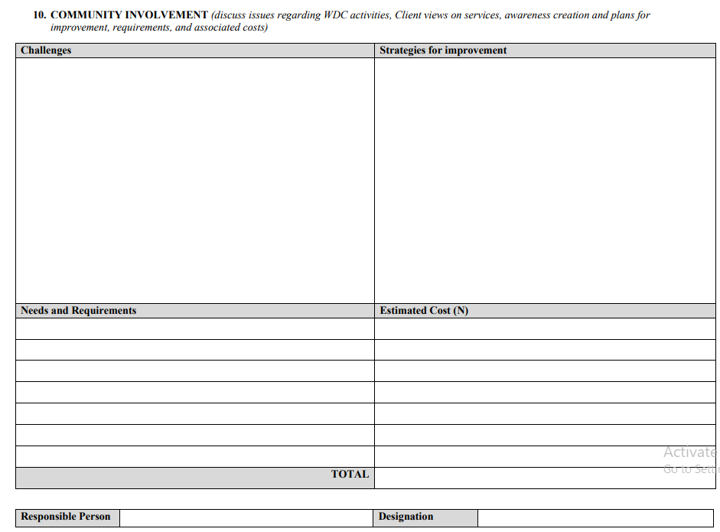
Samples of PHC Financial Documents
Annual Quality Improvement Plan Template

Slide 124
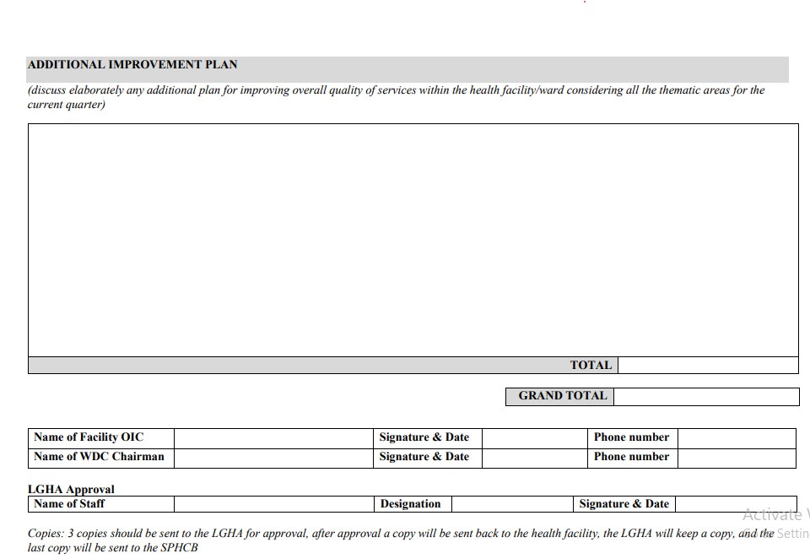
Samples of PHC Financial Documents
Annual Quality Improvement Plan Template
Click here to view the sample document.

Slide 125
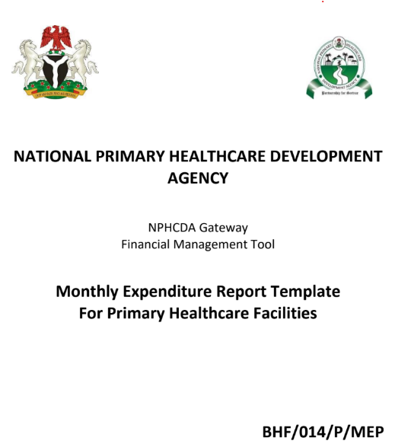
Samples of PHC Financial Documents
Monthly Expenditure Report Template
1. Cover Page

Slide 126
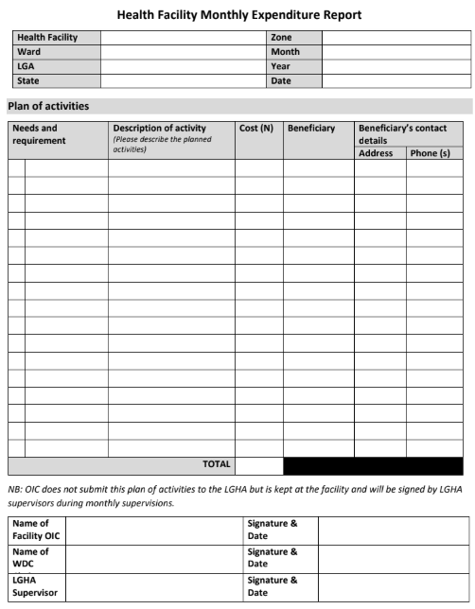
Samples of PHC Financial Documents
Monthly Expenditure Report Template
Click here to view the sample document.

Slide 127

Samples of PHC Financial Documents
Quarterly Business Plan Summary
for Local Government Health Authority
Cover Page

Slide 128
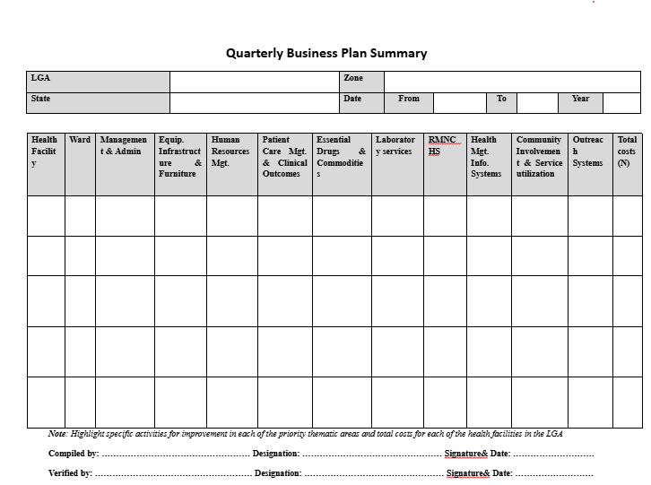
Samples of PHC Financial Documents
Quarterly Business Plan Summary
for Local Government Health Authority
Click here to view the sample document.

Slide 129
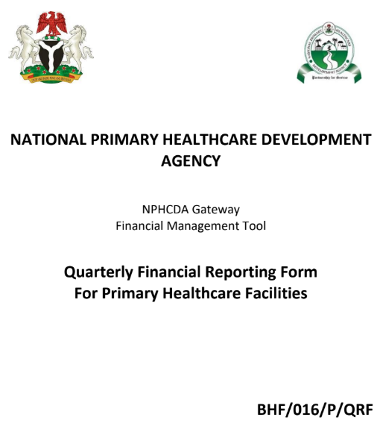
Samples of PHC Financial Documents
Quarterly Financial Reporting Form
Cover Page

Slide 130
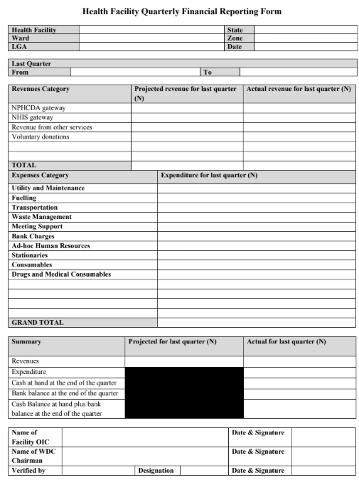
Samples of PHC Financial Documents
Quarterly Financial Reporting Form
Click here to view the sample document.

Slide 131
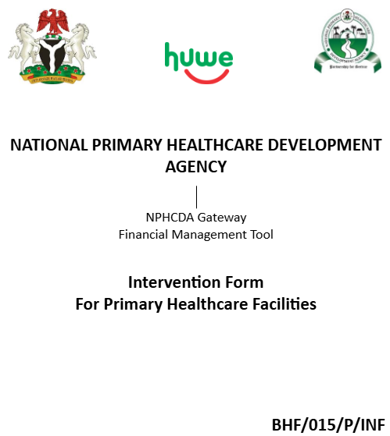
Samples of PHC Financial Documents
Intervention Form Template
Cover Page

Slide 132
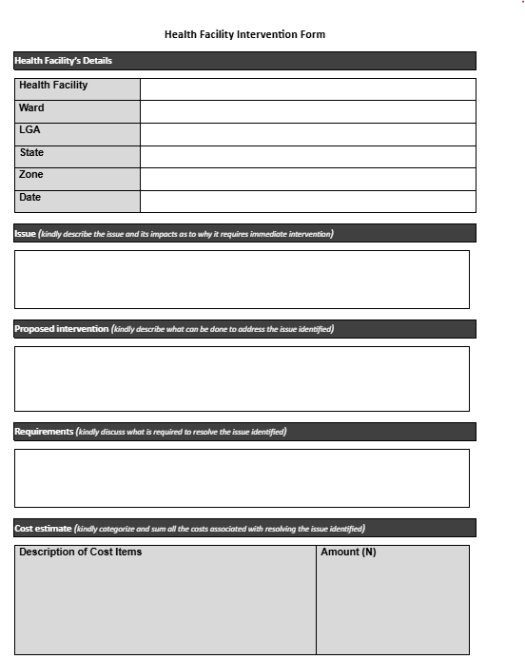
Samples of PHC Financial Documents
Intervention Form Template

Slide 133
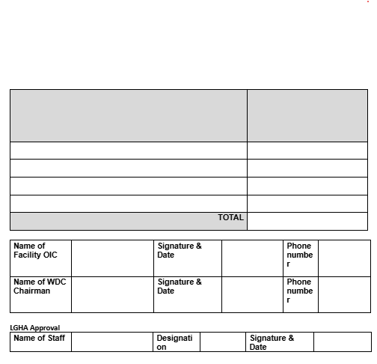
Samples of PHC Financial Documents
Intervention Form Template
Click here to view the sample document.

Slide 134
HOW TO IDENTIFY FINANCIAL RED FLAGS 2/2
Red flags
Description
Ghost Workers (Fake Employees)
Salaries are paid to people who do not work at the PHC.
Example: A staff member who resigned months ago still receives a salary.
Funds Not Deposited in the PHC Account
Money meant for the PHC is collected in cash but never deposited into the official account.
Example: A donor provides ₦1 million for maternal health services, but the funds do not appear in PHC financial records
Stock and Inventory
Goods are missing, expired stock is still being used, or high-value items are disappearing without explanation.
Buying Goods and Services
No competitive bidding, contracts awarded to unqualified vendors.

Slide 135



REPORTING FINANCIAL IRREGULARITIES
If a PFMO confirms irregular financial activity, they must act immediately using these steps:
1
2
Document the Problem
Upload it on your work tool
  Write down the details: what happened, when, who was involved, and how it was discovered.
  Keep copies of receipts, invoices, and any supporting documents.
Bring it to the immediate attention of your state lead.

Slide 136

ROLE OF PFMOS IN FINANCIAL OVERSIGHT
Tracking Cash Flow
Checking Transactions
PFMOs help protect PHC money by ensuring all transactions are transparent and properly documented. Their key responsibilities include:
Monitor all money coming in and out of the PHC.
Ensure spending follows the approved budget.
Monitoring Compliance
Reviewing Reports
Conducting Routine Checks
Supporting PHC Staff
Make sure PHC financial rules and cash limits are followed.
Compare financial reports with actual spending records.
Regularly review cashbooks, receipts, and procurement documents.
Help train PHC staff on proper financial procedures.

Slide 137

CONCLUSION
Effective financial management is essential for Primary Health Care (PHC) centers to provide quality healthcare services and maintain public trust. Performance and Financial Management Officers (PFMOs) play a critical role in this process; their responsibilities include monitoring financial activities, ensuring compliance with budgets, and identifying and reporting any financial irregularities. This module teaches the PFMOs on how to help prevent financial misuse at the PHC through regular oversight, accurate documentation, and prompt reporting.

Slide 139
MODULE 4:
Data Collection and PHC Support

Slide 140
TABLE OF CONTENT
1
5
Maintaining Security Awareness and Safety Measures
Introduction
Learning Objectives
Security Awareness During PHC Visits
Handling Hostility and Harassment
Emergency Protocols for High-Risk Situations
Post-Incident Procedures
Key Takeaways
2
Data Categories
Data points & Sources
3
6
Data Collection Methods & Tools
Conclusion
4
Receiving and Providing Feedback to the health Facility Workers
Principles of Effective Feedback
Receiving Feedback from Health Facility Workers
Providing Feedback to Health Facility Workers
Module 4 - Data Collection and PHC Support

Slide 141

INTRODUCTION
This module equips Performance and Financial Management Officers (PFMOs) with essential skills and knowledge to enhance performance and financial oversight in PHCs.
KEY FOCUS AREAS:
PFMOS WILL LEARN TO CONDUCT STRUCTURED DATA COLLECTION, ROUTINE VISITS, AND SPOT CHECKS TO ENSURE TRANSPARENCY, ACCOUNTABILITY, AND CONTINUOUS SERVICE IMPROVEMENT.

Slide 142
LEARNING OBJECTIVES
BY THE END OF THIS MODULE, PFMOs WILL BE ABLE TO:
  Conduct effective routine visits and spot checks at PHCs to ensure compliance with compliance with BHCPF financial protocols and guidelines and facility performance.
  Collect accurate and relevant data using standardized tools and methodologies for effective decision-making.

Slide 143






DATA CATEGORIES
Data collected at PHCs can be classified into the following categories:
1
2
3
4
Health Programs Data
Human Resources Data
Infrastructure Data
Financial Data
This includes information on maternal delivery and child health, immunization, antenatal and postnatal care, family planning, and other public health interventions.
Records on staffing levels at the PHC.
Documentation on facility conditions, availability of functional backup power supply system, and maintenance records.
Track disbursement to PHC, expenditure and book keeping processes

Slide 144






DATA POINTS & SOURCES
Health Service Utilization
Collected from patient registers, service delivery logs, outpatient and inpatient records.
Financial Reports
Derived from Business Plans and expenditure records.
Human Resources Records
Sourced from staff attendance logs and observation.
Facility Readiness Assessments
Gathered through equipment inventory checklists, facility maintenance logs and observation.

Slide 145



DATA COLLECTION METHOD AND TOOL
PFMOs collect routine data at Primary Healthcare Centers (PHCs) twice a month. To ensure efficiency and accuracy, they use tablets equipped with the PFMO Analytics Platform (PAP), a user-friendly application designed for PHC monitoring.
The app works online and offline, ensuring data can be collected even in areas with limited connectivity.
PFMOs must follow established protocols to maintain consistency and accuracy during every visit.
Key Data Collection Methods
Photo Capture
Voice Recording
Take pictures to document facility conditions or equipment status.
Record audio notes for quick observations and interviews.
Manual Input
Enter figures and observations directly into the PAP app.

Slide 146
RECEIVING AND PROVIDING FEEDBACK TO THE HEALTH FACILITY WORKERS
Effective communication with health facility workers is essential for improving health service delivery by addressing challenges and ensuring continuous improvements.
01
02
A PFMO must be clear on how to receive and provide feedback constructively.
Feedback should be handled effectively, regardless of whether staff members are cooperative or resistant.
?? Don’t understand
03

Slide 147






PRINCIPLES OF EFFECTIVE FEEDBACK
Feedback should be
Clear & Specific
Objective & Constructive
Timely
Provide feedback as soon as possible after an event.
Focus on facts, not assumptions.
Address actions, not personalities.
Solution-Oriented
This should be purely HRH principle based
Two-Way
Allow the health workers to express their views.
Aim to solve problems, not blame individuals.

Slide 148






RECEIVING FEEDBACK FROM HEALTH FACILITY WORKERS
1/2
When a Facility Staff is Cooperative
Listen Actively
Acknowledge Their Views
Maintain eye contact and nod to show understanding.
Use phrases like “I understand your concerns” or “That’s a valid point”.
Clarify & Summarize:
Repeat back key points to confirm understanding.
Take Notes
Respond Professionally
Record key concerns and observations.
Address concerns with possible solutions or escalate issues as needed.
What of feedback to LGHA?

Slide 149
RECEIVING FEEDBACK FROM HEALTH FACILITY WORKERS
2/2
When a Facility Staff is Resistant
Stay Calm & Respectful
Ask Open-Ended Questions
Avoid being defensive or confrontational.
Encourage discussion with “Can you help me understand why this is a challenge?”
Focus on Common Goals
Remind them you are there to help improve service delivery.
Acknowledge Their Concerns
Redirect the Discussion
Show empathy by saying, “I understand this might be frustrating.”
If emotions rise, bring the conversation back to solutions.

Slide 150
PROVIDING FEEDBACK TO HEALTH FACILITY WORKERS
WHEN A FACILITY STAFF IS COOPERATIVE
WHEN A FACILITY STAFF IS RESISTANT
1
1
Start with Positives
Stay Professional & Factual
“I appreciate how your team keeps patient records up to date.”
Avoid emotional or personal criticism.
2
2
Use Data & Observations
Be Firm but Respectful:
“We noticed that stock levels are often low. How can we improve this?”
This issue affects service delivery, and we must find a solution.”
3
3
Encourage Participation:
Give Examples & Consequences:
“What do you think could help improve this?”
“If records are incomplete, funding may be delayed.”
4
4
Offer Support:
Engage Senior Staff or Leadership if Needed
“Let’s work together to find solutions.”
If resistance persists, escalate appropriately to the State Lead.
5
Follow-up
Document their feedback and ensure action steps are taken.

Slide 151



MAINTAINING SECURITY AWARENESS AND SAFETY MEASURES
Visiting Primary Healthcare Centers (PHCs) in your assigned Local Government Area (LGA) is a key responsibility of a PFMO.
This training provides skills to enhance security awareness, de-escalate tense situations, and ensure personal safety.
Some areas may pose security risks, including hostility and harassment.

Slide 152



SECURITY AWARENESS DURING PHC VISITS
1/2
Pre-Visit Safety Preparation
1
2
3
4
5
Know the Area
Plan Your Route:
Inform Your Supervisor
Carry Identification:
Emergency Contacts
Research the LGA's security conditions before visiting. Check recent security alerts or incidents.
Use safe and well-traveled routes. Avoid isolated areas.
Share your itinerary, the expected duration of the visit, and contact information.
Always carry your official ID and any authorization letters.
Keep a list of emergency contacts, including local security agencies and your organization’s security unit.

Slide 153







SECURITY AWARENESS DURING PHC VISITS
2/2
On-Site Safety Measures
1
2
3
4
5
Stay Alert
Maintain Professionalism
Limit Exposure
Avoid Heated Arguments
Stay in Control
Be aware of your surroundings and identify potential exit routes.
Approach everyone respectfully, but remain cautious.
Spend only the necessary amount of time at the PHC.
If tensions arise, remain calm and professional.
If a situation becomes unsafe, leave immediately and report the incident.

Slide 154



HANDLING HOSTILITY AND HARASSMENT
De-escalation Techniques
  Stay Calm: Control your emotions and maintain a neutral tone.
  Maintain Space: Keep a safe distance from the person exhibiting hostility.
  Listen Actively: Let the individual express their concerns without interrupting.
  Acknowledge Concerns: Use phrases like “I understand your frustration” or “Let’s find a solution together”.
  Set Boundaries: Firmly but respectfully state that threats and harassment are unacceptable.
  Know When to Exit: If the situation escalates, prioritize your safety by leaving the premises.
Types of Hostility You May Encounter
  Verbal Abuse: Insults, shouting, or threats.
  Physical Threats: Intimidating gestures or attempts to cause harm.
  Group Hostility: Collective resistance or aggressive behavior from multiple individuals

Slide 155



EMERGENCY PROTOCOLS FOR HIGH-RISK SITUATIONS
Post-Incident Procedures
If You Encounter Threats or Violence
If you experience any form of hostility or harassment during your visit:
  Document the Incident: Record the time, location, individuals involved, and a detailed description of what happened.
  Report to Your Supervisor: Notify your supervisor or designated contact person immediately.
  Review Security Protocols: Reflect on the situation to identify ways to improve security awareness and preparedness for future visits.
  Do Not Engage: Avoid arguing or attempting to reason with someone who is aggressive.
  Create Distance: Move toward the nearest exit without turning your back on the threat.
  Alert Security: Call local law enforcement or your organization’s security team if necessary.

Slide 156

KEY TAKEAWAYS
5.
4.
Document and report all security incidents to ensure accountability and future prevention.
3..
Know when to disengage and report incidents to the appropriate authorities.
2.
Use clear, respectful communication to de-escalate tense situations.
1.
Stay calm, professional, and solution-focused when dealing with hostility.
Always prioritize your safety and leave any situation that feels unsafe

Slide 157

CONCLUSION
  Accurate data collection and effective support are crucial for improving Primary Healthcare Centers (PHCs) performance.
  PFMOs play a key role by gathering reliable data, monitoring service delivery, and providing constructive feedback.
  Success depends on using tools like the Analytics Platform for data collection and maintaining security awareness.
  Following safety protocols during visits ensures both personal safety and operational effectiveness.
  Diligence and professionalism help promote transparency, accountability, and continuous improvement.
  PFMOs contribute to strengthening Nigeria’s healthcare system through their efforts.

Slide 158


ACRONYMS
BHCPF: Basic Health Care Provision Fund
BMPHS: Basic Minimum Package of Health Services
CHEW: Community Health Extension Worker
CHO: Community Health Officer
CRF: Consolidated Revenue Fund
LGHA: Local Government Health Authority
NHIS: National Health Insurance Scheme
NPHCDA: National Primary Health Care Development Agency
NSHRII: Nigeria Health Sector Renewal Investment Initiative
PFMO: Performance and Financial Management Officer
PHC: Primary Health Center
SMOH: State Ministries of Health
SPHCDA: State Primary Health Care Development Agency
UHC: Universal Health Coverage
WDC: Ward Development Committee

Slide 159
DEFINITION OF TERMS
  Accountability: Responsibility for actions and transparent reporting.
  Basic Health Services: Includes immunization, maternal care, treatment of common illnesses, health education, and referrals.
  BHCPF: Fund for PHC financing.
  BMPHS: Service standards for PHCs.
  Capacity Building: Training PHC staff.
  CHEW/CHO: Community-based healthcare workers.
  Comprehensive PHC Services: Advanced services like diagnostics, dental, and chronic disease management.
  CRF: BHCPF funding source.
  Data Collection: Gathering PHC data for analysis.
  Deliverables: Reports and training outputs.
  Financial Oversight: Monitoring PHC funds.
  Funding: PHC financial sources.
  Governance: PHC management structures.
  Health Centers/Clinics/Posts: See PHC.
  LGHA: Local PHC management authority.
  Milestones: Key program achievements.
  NHIS: PHC financing through insurance.
  NPHCDA: National PHC oversight agency.
  NSHRII: Initiative for UHC by 2030.
  Operational Support: Assistance in staffing and supplies.
  PFMO: PHC financial and operational managers.
  PHC: First-level healthcare facility.
  Primary Healthcare: Accessible and affordable care.
  Service Delivery: Providing healthcare services.
  SMOH: State-level health policy agency.
  SPHCDA: State PHC coordination agency.
  Stakeholder Collaboration: Working with key groups for better healthcare.
  Transparency: Open and clear operations.
  UHC: Access to quality healthcare for all.
  WDC: Community PHC oversight groups.
  Work Scope: PFMO responsibilities.

Slide 160

QUESTIONS

