Slide 1

Bayelsa State RMNCAHN Report for August, 2024
Data Source: DHIS2
Data was downloaded September 20, 2024

Slide 2
Presentation Outline
  Brief State background
  Reports of key indicators
  Maternal indicators
    LGA Performance
  Child health indicators
  Key Findings

Slide 3

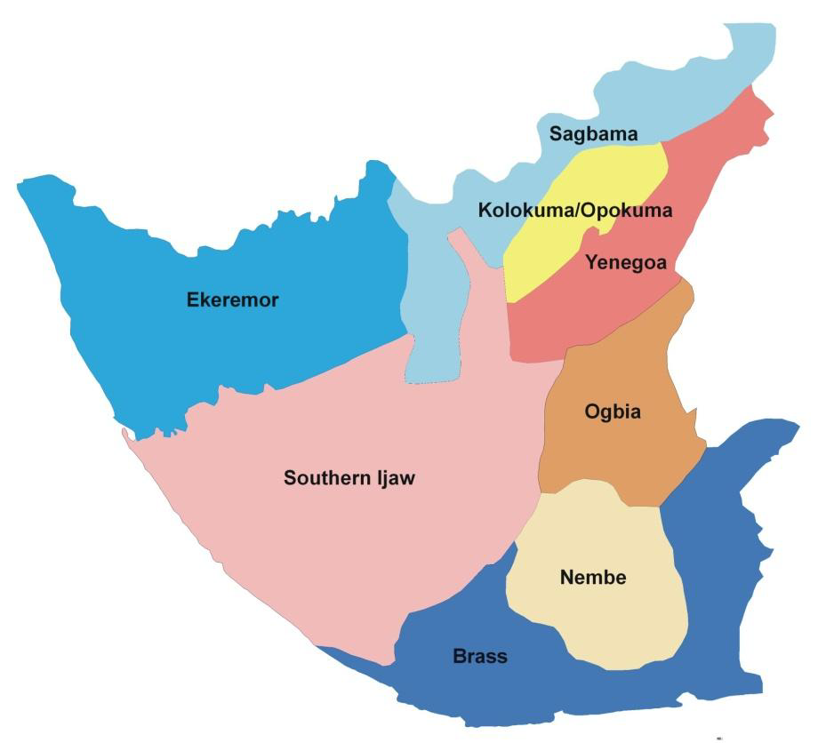






State Background
2,769,283
8
110,771
553,857
138,646
RMNCAH+N Facilities
299 HF
105

Slide 4
Maternal Health Indicators

Slide 5
Comparing % of Deliveries Taken by Skilled Birth Attendants in January – August 2024
 | Jun-24 | Jul-24 | Aug-24
Total Deliveries | 939 | 990 | 791
SBA Delievries | 922 | 942 | 773

Slide 6
Comparing % of Deliveries Monitored using Partograph in January – August 2024
 | Jun-24 | Jul-24 | Aug-24
Total Deliveries | 939 | 990 | 791
Monitored with Partograph | 736 | 758 | 632

Slide 7
HFs with Subpar SBA Reports for August 2024
LGA | PHC | Total Deliveries | Deliveries by SBAs
Ekeremor | Orobiri PHC | 1 | 0
 | Peretorugbene PHC | 8
Nembe | Nembe General Hospital | 2 | 0
 | Obioku PHC | 4 | 0
 | Nembe PHC | 8 | 0
Southern Ijaw | Anyama PHC | 1 | 0
 | Ogboinbiri Cottage Hospital | 2 | 7
 | Oporoma PHC | 3 | 4
Yenagoa | Delightsome Hospital | 5 | 3

Slide 8
ANC Access and Utilization for January – August 2024

Slide 9
BRASS
BRASS | August 2024 ANC Attendance | August 2024 ANC 1st Visit | August 2024 ANC 4th visit
Ibidi PHC | 0 | 0 | 0

Slide 10
KOLOKUMA/OPOKUMA
KOLGA | August 2024 ANC Attendance | August 2024 ANC 1st Visit | August 2024 ANC 4th visit
Alaere Alaibe Clinic | 0 | 0 | 0
Ofonigbene | 0 | 0 | 0
Kalama PHC | 0 | 0 | 0

Slide 11
NEMBE
NEMBE | August 2024 ANC Attendance | August 2024 ANC 1st Visit | August 2024 ANC 4th visit
Itieama PHC | 0 | 0 | 0
Igbeta-ewoama PHC | 0 | 0 | 0
Nembe Creek PHC | 0 | 0 | 0
Ologoama PHC | 0 | 0 | 0

Slide 12
OGBIA
OGBIA | August 2024 ANC Attendance | August 2024 ANC 1st Visit | August 2024 ANC 4th visit
Akipelai Cottage Hospital | 0 | 0 | 0
Ibelebiri PHC | 0 | 0 | 0
Idema Cottage Hospital | 0 | 0 | 0
Otuabula 2 PHC | 0 | 0 | 0
Otuasega PHC | 0 | 0 | 0
Total Care Clinic | 0 | 0 | 0

Slide 13
SAGBAMA
SAGBAMA | August 2024 ANC Attendance | August 2024 ANC 1st Visit | August 2024 ANC 4th visit
Akeddei PHC | 0 | 0 | 0
Anyama-Ibeni PHC | 0 | 0 | 0
Eriama PHC | 0 | 0 | 0
Kanaan PHC | 0 | 0 | 0
Okumbiri PHC | 0 | 0 | 0

Slide 14
SOUTHERN IJAW
SILGA | August 2024 ANC Attendance | August 2024 ANC 1st Visit | August 2024 ANC 4th visit
Amatolo PHC | 0 | 0 | 0
Ikebiri PHC | 0 | 0 | 0
Igeibiri PHC | 0 | 0 | 0
Ikienghenbiri PHC | 0 | 0 | 0
Ozezibiri PHC | 0 | 0 | 0
Kokologbene PHC | 0 | 0 | 0
Koluama 1 PHC | 0 | 0 | 0
Oweikorogha PHC | 0 | 0 | 0
Tugogbene PHC | 0 | 0 | 0

Slide 15
YENAGOA
YENAGOA | August 2024 ANC Attendance | August 2024 ANC 1st Visit | August 2024 ANC 4th visit
Agbura PHC | 0 | 0 | 0
Akaibiri PHC | 0 | 0 | 0
Ayama PHC | 0 | 0 | 0
Bumoundi-gbene PHC | 0 | 0 | 0
Egbebiri PHC | 0 | 0 | 0
Nedugo PHC | 0 | 0 | 0
Ogboloma PHC | 0 | 0 | 0
Ogu PHC | 0 | 0 | 0
Tuburu PHC | 0 | 0 | 0
Yenaka Primary Health Clinic | 0 | 0 | 0
Yenegwe PHC | 0 | 0 | 0
Bayelsa State House of Assembly Clinic | 0 | 0 | 0
Diete-Koki Memorial Hospital | 0 | 0 | 0
Ikibiri Cottage Hospital | 0 | 0 | 0
Yenagoa Federal Medical Centre | 0 | 0 | 0
Nigeria Air Force Medical Centre | 0 | 0 | 0
Niger Delta University Teaching Hospital | 0 | 0 | 0

Slide 16
YENAGOA
YENAGOA | August 2024 ANC Attendance | August 2024 ANC 1st Visit | August 2024 ANC 4th visit
Alfa Clinic | 0 | 0 | 0
Ark Hospital | 0 | 0 | 0
Believer's Faith Medical Clinic | 0 | 0 | 0
De George Hospital | 0 | 0 | 0
Divine Grace Medical Centre | 0 | 0 | 0
Ebiekure PHC | 0 | 0 | 0
Family Care | 0 | 0 | 0
Frank west Specialist Hospital | 0 | 0 | 0
Hoffman and Bright Hospital | 0 | 0 | 0
Mercy & Favour Clinic & Diagnostic Services | 0 | 0 | 0
The Bay Clinic | 0 | 0 | 0
Mercy Seat Hospital And Medical Service Ltd | 0 | 0 | 0

Slide 17
CHILD HEALTH

Slide 18
Nutrition: Comparing Selected Indicators for Bayelsa – January - August 2024

Slide 19
Child Health: Selected Indicators for Bayelsa in August, 2024

Slide 20
Key Findings
ANC coverage (1st Visit) stands at 12%
Performance in Nutrition dropped, with 3% of 6-59 months children receiving Vit A supplementation and 6% of children aged 6-59 months being exclusively breastfed. The percentage of dewormed children also drastically reduced to 2%
SBA coverage stands at 98% while Deliveries monitored with partograph in August 2024 stood at a rate of 80%.
57 HFs across 7 LGAs with no ANC reports for the month of August, 2024

Slide 21
ACTION PLAN
Issues Identified | Mitigation | Recommendation | Responsible Person
Low ANC Access (ANC1 Visits) Poor ANC Utilization (ANC4 Visits) | Engaged caregivers in 12 Yenagoa facilities on ANC importance. Held Safe Motherhood sessions in 6 communities on maternal health and ANC. Tracked ANC service uptake across the state. Planned advocacy meetings with new LGA chairmen to encourage health initiative support. | Set monthly ANC1 targets for PHCs with close monitoring and reward facilities meeting targets (DPHCs). Engage community leaders and institutions for ANC awareness via town hall meetings and religious gatherings (LEMCHIC Coordinators and HPOs). Conduct door-to-door outreach, providing services like SPs and vaccinations, with proper documentation . Offer free consultation or service fees for first ANC visits at PHCs. | DPHCs LEMCHIC Coordinators HPOs/SMOs LGA M&E

Slide 22
THANK YOU

